Slide 1
Pure Substances
Materials are made of a pure substance or a mixture of substances.
A pure substance, or simply a substance, is a type of matter with a fixed composition.
A substance can be either an element or a compound.

Slide 2
Elements
All substances are built from atoms. If all the atoms in a substance have the same identity, that substance is an element.
The graphite in your pencil point and the copper coating of most pennies are examples of elements.
About 90 elements are found on Earth.
More than 20 others have been made in laboratories, but most of these are unstable and exist only for short periods of time.

Slide 3
Elements
About 90 elements are found on Earth.
More than 20 others have been made in laboratories, but most of these are unstable and exist only for short periods of time.

Slide 4
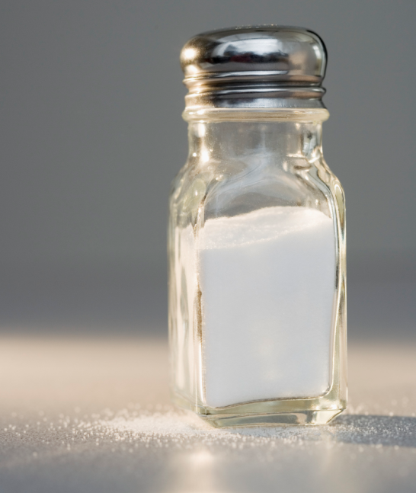
Compounds
Can you imagine yourself putting something made from a slivery metal and a greenish-yellow, poisonous gas on your food?
Table salt is a chemical compound that fits this description. Even though it looks like white crystals and adds flavor to food, its components—sodium and chlorine—are neither white nor salty.
CORBIS

Slide 5
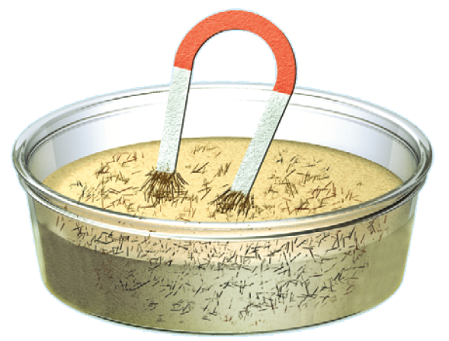
Mixtures
A mixture, such as the iron filings and sand, is a material made up of two or more substances that can be easily separated by physical means.

Slide 6
Heterogeneous Mixtures
Unlike compounds, mixtures do not always contain the same proportions of the substances that make them up.
A mixture in which different materials can be distinguished easily is called a heterogeneous (he tuh ruh JEE nee us) mixture.

Slide 7
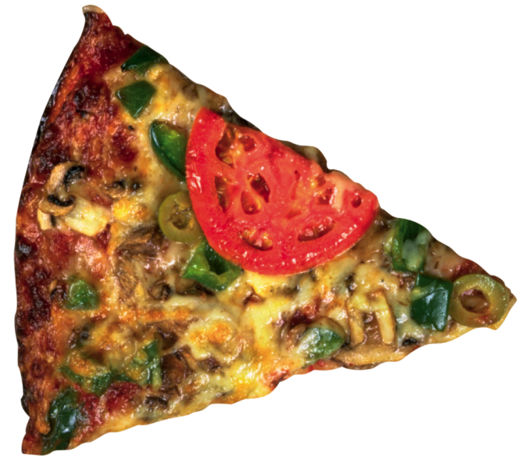
Heterogeneous Mixtures
Most of the substances you come in contact with every day are heterogeneous mixtures. Some components are easy to see, like the ingredients in pizza, but others are not.
For example, the cheese in pizza is also a mixture, but you cannot see the individual components.
Ingram Publishing / Alamy

Slide 8
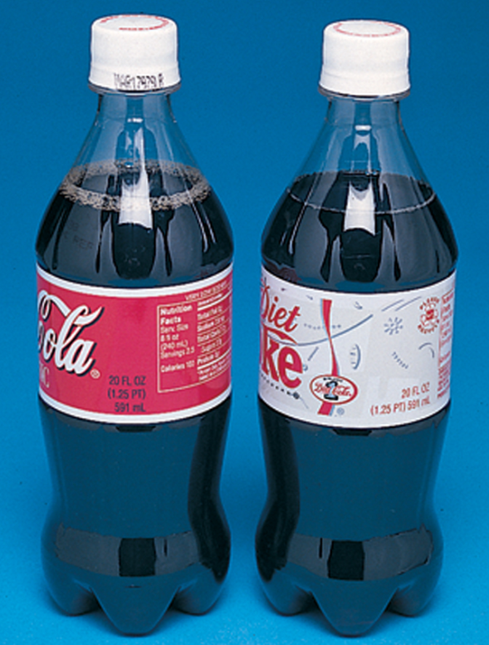
Homogeneous Mixtures
Soft drinks contain water, sugar, flavoring, coloring, and carbon dioxide gas.
Soft drinks in sealed bottles are examples of homogeneous mixtures.
The McGraw-Hill Companies, Inc./Bob Coyle, photographer

Slide 9
Homogeneous Mixtures
A homogeneous (hoh muh JEE nee us) mixture contains two or more gaseous, liquid, or solid substances blended evenly throughout.

Slide 10
Homogeneous Mixtures
Another name for homogeneous mixtures like a cold soft drink is solution.
A solution is a homogeneous mixture of particles so small that they cannot be seen with a microscope and will never settle to the bottom of their container.

Slide 11
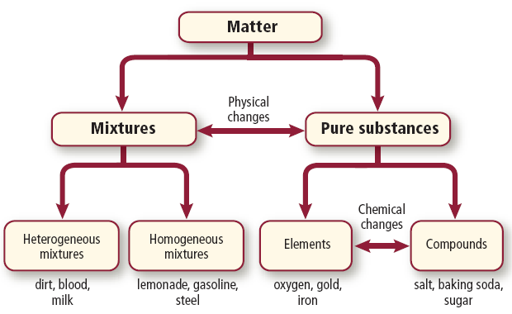
Homogeneous Mixtures
Solutions remain constantly and uniformly mixed.

Slide 12
Colloids
Milk is an example of a specific kind of mixture called a colloid.
A colloid (KAH loyd) is a type of mixture with particles that are larger than those in solutions but not heavy enough to settle out.

Slide 13
Detecting Colloids
One way to distinguish a colloid from a solution is by its appearance.
Fog appears white because its particles are large enough to scatter light.
Sometimes it is not so obvious that a liquid is a colloid.
You can tell for certain if a liquid is a colloid by passing a beam of light through it.

Slide 14
Detecting Colloids
A light beam is invisible as it passes through a solution, but can be seen readily as it passes through a colloid. This occurs because the particles in the colloid are large enough to scatter light, but those in the solution are not.
This scattering of light by colloidal particles is called the Tyndall effect.

Slide 15
Suspensions
Some mixtures are neither solutions nor colloids. One example is muddy pond water.
Pond water is a suspension, which is a heterogeneous mixture containing a liquid in which visible particles settle.

Slide 16
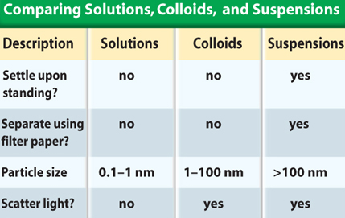
Types of Mixtures
The table summarizes the properties of different types of mixtures.

Slide 17
Section Check
Question 1
A _______ is a type of matter with a fixed composition.
A. colloid
B. mixture
C. substance
D. solution

Slide 18
Section Check
Answer
The answer is C. A substance can be either an element or a compound.

Slide 19
Section Check
Question 2
Approximately how many elements are naturally found on Earth?
A. 5
B. 10
C. 30
D. 90

Slide 20
Section Check
Answer
The answer is D. About 90 elements are found on Earth, and more than 20 have been made in laboratories.

Slide 21
Section Check
Question 3
How are compounds different from mixtures?

Slide 22
Section Check
Answer
The atoms in compounds are combined in fixed proportions and cannot be separated by physical means. A mixture is made of two or more substances that can be easily separated by physical means.

