Slide 1
Reaction Rates
Some reactions—such as the combustion of rocket fuel—proceed very rapidly. Other reactions—such as metal rusting—proceed very slowly.
The reaction rate is the rate at which reactants change into products.
According to the collision model, reactants must collide in order to react.

Slide 2
Temperature
Increasing temperature increases the reaction rate.
Temperature is a measure of the average kinetic energy of a substance’s particles. The higher the temperature, the faster the particles are moving.
Faster-moving particles means more frequent collisions and collisions with greater energy.

Slide 3
Concentration
Increasing the concentration of the reactants increases the reaction rate.
Increased concentration means a greater number of reacting particles in a given area.
Greater numbers of particles means more opportunities for collisions between reacting particles.

Slide 4
Volume and Pressure
Volume and pressure are important considerations for reactions involving gases.
Decreased volume leads to increased concentration. Increasing the concentration of gases increases the rate at which partilces collide with each other and with the walls of their container.

Slide 5
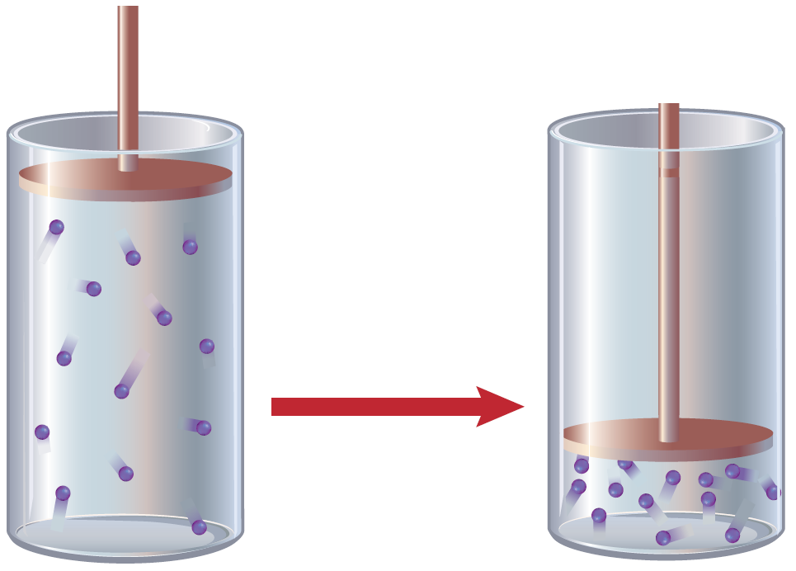
Volume and Pressure
Increased collisions mean increased pressure.
The reaction rate also increases because the reacting particles collide with each other more frequently.

Slide 6
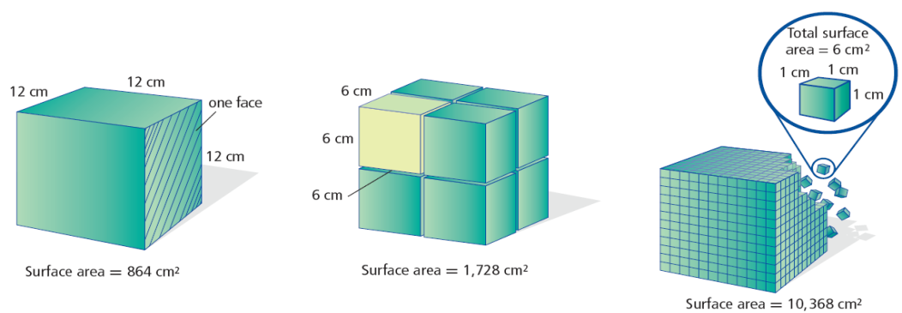
Surface Area
Sugar cubes dissolve more slowly compared to granulated sugar. The individual grains of sugar have a greater total surface area.
Increased surface area leads to faster reactions. This larger area allows for more collisions between reacting particles.

Slide 7
Catalysts and Inhibitors
Some reactions proceed too slowly to be useful.
To speed them up, a catalyst can be added.
A catalyst is a substance that speeds up a chemical reaction without being permanently changed itself.

Slide 8
Catalysts and Inhibitors
When you add a catalyst to a reaction, the mass of the product that is formed remains the same, but it will form more rapidly.

Slide 9
Catalysts and Inhibitors
At times, it is worthwhile to prevent certain reactions from occurring.
Substances called inhibitors are used to slow down a chemical reaction.
One thing to remember when thinking about catalysts and inhibitors is that they do not change the amount of product produced. They only change the rate of production.

Slide 10
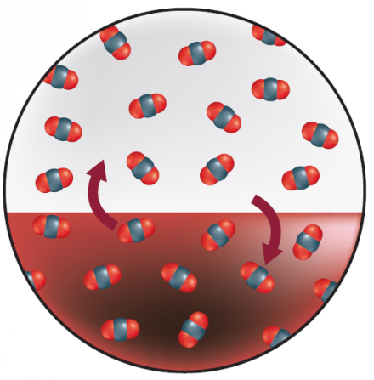
Equilibrium
A reversible reaction is one that can move both forward (reactants → products) and in reverse (products → reactants).
When the forward and reverse reactions are occurring at the same rate, the reaction has reached equilibrium.
Equilibria can exist for both physical changes and chemical reactions.

Slide 11
Factors Affecting Equilibria
Le Châtelier’s principle states that as a stress is applied to a system at equilibrium, the equilibrium shifts in the direction that opposes the stress.
Common stresses include changing the concentration of reactants or products, changing temperature, or changing volume and pressure.

Slide 12
Factors Affecting Equilibria
An increase in reactant concentration causes a shift to the right (toward products). A decrease in product concentration also causes a shift toward products.
For reactions between gases, an increase in pressure leads to a shift in whichever direction will produce fewer particles (and lead to lower pressure).

Slide 13
Section Check
Question 1
Which will not increase the rate of a chemical reaction?
A. increasing temperature
B. increasing pressure
C. increasing volume
D. increasing concentration

Slide 14
Section Check
Answer
The answer is C. Increasing the volume will decrease the concentration of reacting particles and make collisions less likely.

Slide 15
Section Check
Question 2
If a reversible reaction has equal quantities of reactants and products can it be considered to be at equilibrium?

Slide 16
Section Check
Answer
No. A reversible reaction has reached equilibrium when the rates of the forward and reverse reactions are equal.
The quantities of reactants and products do not have to be equal when a reaction is at equilibrium.

Slide 17
Section Check
Question 3
What is the substance that speeds up a chemical reaction without being permanently changed itself?
Answer
A substance that speeds up a chemical reaction without being permanently changed itself is called a catalyst.

