Slide 1
Reviewing Main Ideas
Simple Organic Compounds
Organic compounds contain carbon. Carbon is an element with a structure that enables it to form a large number of compounds.
Hydrocarbons are made of only hydrogen and carbon.
Saturated hydrocarbons contain only single bonds between carbon atoms. Unsaturated hydrocarbons contain double or triple bonds.

Slide 2
Reviewing Main Ideas
Simple Organic Compounds
Isomers of organic compounds have identical formulas but different molecular shapes.
Benzene rings are stable because electrons are shared by all six carbon atoms, resulting in a rigid planar structure.

Slide 3
Reviewing Main Ideas
Substituted hydrocarbons
In a substituted hydrocarbon, other atoms or groups of atoms take the place of one or more hydrogen atoms.
Alcohols contain –OH groups and organic acids contain –COOH groups.
Esters contain a –COOC group and are often used for flavoring.

Slide 4
Reviewing Main Ideas
Substituted hydrocarbons
Amines contain –NH2 group and mercaptans contain a –SH group.
Halocarbons have one or more hydrogen atoms replaced with a halogen, such as fluorine or chlorine.
Aromatic compounds, many of which have odors, contain the benzene ring structure.

Slide 5
Reviewing Main Ideas
Petroleum—A Source of Carbon Compounds
Petroleum is a mixture of thousands of carbon compounds.
A fractionating tower separates petroleum into groups of compounds or fractions based on their boiling points.

Slide 6
Reviewing Main Ideas
Petroleum—A Source of Organic Compounds
Small hydrocarbons obtained from petroleum can be combined to make long chains called polymers, which are used for plastics.
Polymers can be spun into fibers designed to have specific properties.

Slide 7
Reviewing Main Ideas
Biological Compounds
Proteins, nucleic acids, carbohydrates, and lipids are major groups of biological organic compounds.
Many important biological compounds are polymers, huge organic molecules made of smaller units, or monomers.

Slide 8
Reviewing Main Ideas
Biological Compounds
Proteins are polymers made from amino acids.
Carbohydrates contain carbon, hydrogen, and oxygen. They have twice as many hydrogen atoms as oxygen atoms.
Lipids also contain carbon, hydrogen, and oxygen, but in different proportions. Lipids include fats, oils, and cholesterol.

Slide 9
Reviewing Main Ideas
Biological Compounds
Nucleic acids are made of nucleotide monomers and control the activities and reproductions of cells.
DNA is a nucleic acid found in the nucleus of a cells that contains the genetic code.

Slide 10
Chapter Review
Question 1
Most carbon-containing compounds are _______.
Answer
More than 90 percent of the millions of carbon compounds known today are considered organic.

Slide 11
Chapter Review
Question 2
What type of bond is formed when two atoms share a pair of electrons?
A. ionic
B. covalent
C. metallic
D. acidic

Slide 12
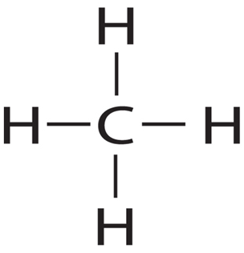
Chapter Review
Answer
The answer is D. A carbon atom has four electrons in its outer energy level and can form four covalent bonds with atoms of carbon or other elements.

Slide 13
Chapter Review
Question 3
Which has a structural isomer with the chemical formula C₄H₁₀?
A. methane
B. ethane
C. propane
D. butane

Slide 14
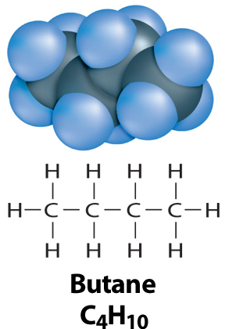
Chapter Review
Answer
The answer is D. Butane and isobutene both have four carbon and ten hydrogen atoms.

Slide 15
Chapter Review
Question 4
Hydrocarbons that have hydrogen atoms replaced with different groups of atoms are called __________.

Slide 16
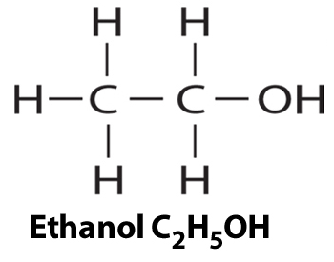
Chapter Review
Answer
Substituted hydrocarbons have one or more of their hydrogen atoms replaced by atoms or groups of other elements.

Slide 17
Chapter Review
Question 5
_________ are compounds containing carbon, hydrogen and oxygen, and include sugars and starches.

Slide 18
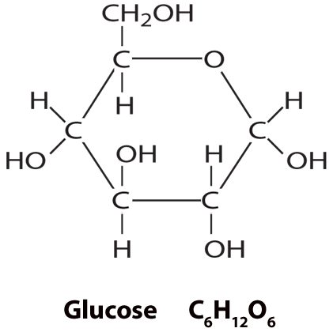
Chapter Review
Answer
These compounds are called carbohydrates and have twice as many hydrogen atoms as oxygen atoms.

Slide 19
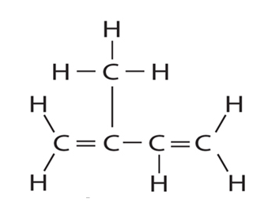
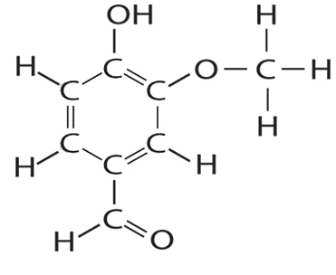
Standardized Test Practice
Question 1
Which is a saturated hydrocarbon?
A.
B.

Slide 20
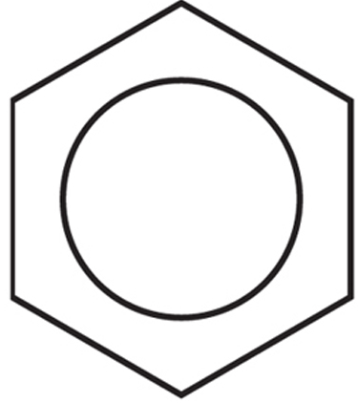
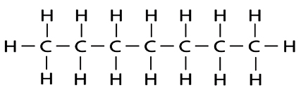
Standardized Test Practice
C.
D.

Slide 21
Standardized Test Practice
Answer
The answer is C. Isoprene and benzene are hydrocarbons, but are not saturated. Heptane is the saturated hydrocarbon, containing only single-bonded carbon and hydrogen.

Slide 22
Standardized Test Practice
Question 2
How many covalent bonds can a carbon form with other atoms?
A. one
B. two
C. three
D. four

Slide 23
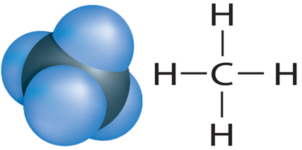
Standardized Test Practice
Answer
The answer is D. A carbon atom has four electrons in its outer energy level and can form four covalent bonds with atoms of carbon or other elements.

Slide 24
Standardized Test Practice
Question 3
The hydrocarbon ethyne contains a triple bond in which _______ pairs of electrons are shared.
A. one
B. two
C. three
D. four

Slide 25
Standardized Test Practice
Answer
The answer is C. Each pair of shared electrons forms a bond; a triple bond has three pairs of shared electrons

Slide 26
Standardized Test Practice
Question 4
Which physical property is used to separate compounds in crude oil?
Color
Boiling point
Melting point
Density

Slide 27
Standardized Test Practice
Answer
The answer is B. Fractional distillation separates the compounds in crude oil by their boiling points.

Slide 28
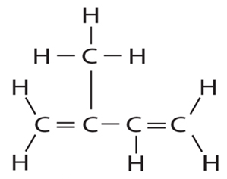
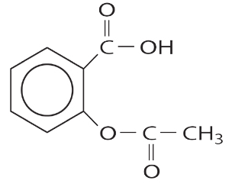
Standardized Test Practice
Question 5
Which of the following structures is a peptide?
A.
B.

Slide 29
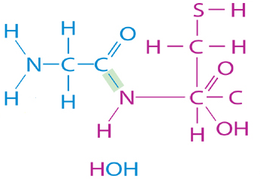
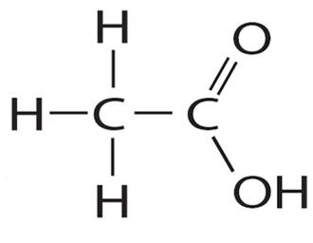
Standardized Test Practice
C.
D.

Slide 30
Standardized Test Practice
Answer
The answer is C. An amine group of one amino acid can combine with the carboxylic acid group of another amino acid to form a peptide.

