Slide 1
Reviewing Main Ideas
Structure of an Atom
A chemical symbol is a shorthand way of writing the name of an element.
An atom consists of a nucleus made of protons and neutrons surrounded by an electron cloud.
Quarks are particles of matter that make up protons and neutrons.
The model of the atom changes over time. As new information is discovered, scientists incorporate it into the model.

Slide 2
Reviewing Main Ideas
Masses of Atoms
The number of neutrons in an atom can be computed by subtracting the atomic number from the mass number.
The isotopes of an element are atoms of that same element that have different numbers of neutrons.

Slide 3
Reviewing Main Ideas
Masses of Atoms
The average atomic mass of an element is the weighted-average mass of the mixture of its isotopes. Isotopes are named by using the element name, followed by a dash, and its mass number.

Slide 4
Reviewing Main Ideas
The Periodic Table
In the periodic table, the elements are arranged by increasing atomic number resulting in periodic changes in properties. Knowing that the number of protons, electrons, and atomic number are equal gives you partial composition of the atom.
In the periodic table, the elements are arranged in 18 vertical columns, or groups, and seven horizontal rows, or periods.

Slide 5
Reviewing Main Ideas
The Periodic Table
Metals are found at the left of the periodic table, nonmetals at the right, and metalloids along the line that separates the metals from the nonmetals.
Elements are placed on the periodic table in order of increasing atomic number. A new row on the periodic table begins when the outer energy level of the element is filled.

Slide 6
Chapter Review
Question 1
Who proposed the idea that atoms make up all substances?
A. Aristotle
B. Socrates
C. Democritus
D. Euripides

Slide 7
Chapter Review
Answer
The answer is C. Later, Aristotle disputed Democritus’s theory and proposed that matter was uniform throughout, not composed of smaller particles.

Slide 8
Chapter Review
Question 2
In order to study quarks, scientists must force __________ to break apart.
A. atoms
B. electrons
C. neutrons
D. protons

Slide 9
Chapter Review
Answer
The answer is D. Particle accelerators are used to accelerate charged particles and force them to collide with protons, breaking them apart.

Slide 10
Chapter Review
Question 3
Describe the model of the atom that is in use today.

Slide 11
Chapter Review
Answer
In the electron cloud model, electrons do not follow fixed orbits as in the Bohr model, but tend to occur more frequently in certain areas around the nucleus at any given time.

Slide 12
Chapter Review
Question 4
Atoms of the same element that have different numbers of neutrons are called __________.
A. isomers
B. isotopes
C. identical
D. isobars

Slide 13
Chapter Review
Answer
The answer is B. Isotopes are identified by using the name of the element followed by the mass number of that isotope, as in boron-10.

Slide 14
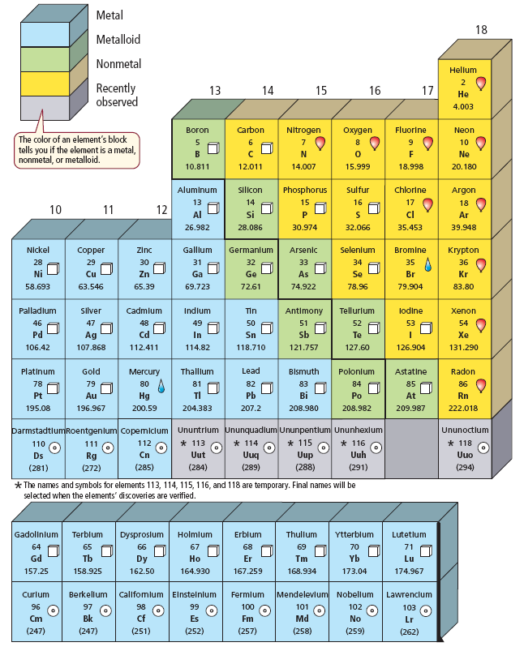
Chapter Review
Question 5
Which group is most likely to contain elements that are good conductors of electricity?

Slide 15
Chapter Review
A. Group 11
B. Group 15
C. Group 16
D. Group 17

Slide 16
Chapter Review
Answer
The answer is A. Group 11 contains metals, which are better conductors of electricity than the nonmetals of Groups 15, 16 and 17.

Slide 17
Standardized Test Practice
Question 1
Which is positively charged?
A. proton
B. neutron
C. electron
D. quark

Slide 18
Standardized Test Practice
Answer
The answer is A. Neutrons are electrically neutral, and electrons are negatively charged.

Slide 19
Standardized Test Practice
Question 2
Based on the table, which of the following statements is correct?

Slide 20
Standardized Test Practice
A. The atomic number is equal to the number of
neutrons in an atom.

Slide 21
Standardized Test Practice
B. The symbol for each element in the periodic
table is the first letter of the name of the
element.

Slide 22
Standardized Test Practice
C. If you know the mass number and the atomic
number of an atom, you can calculate the
number of neutrons in the atom.

Slide 23
Standardized Test Practice
D. Atoms of the same element always have the
same number of neutrons.

Slide 24
Standardized Test Practice
Answer
The answer is C. The mass number of an atom is the sum of the number of protons and the number of neutrons in the nucleus of an atom.

Slide 25
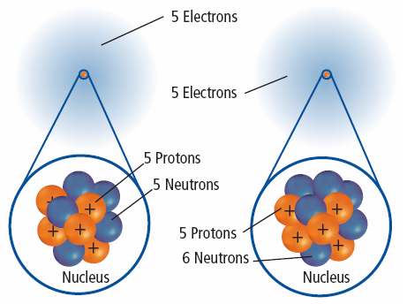
Standardized Test Practice
Question 3
The atomic number of boron is 5; the atomic number of carbon is 6. Name the isotopes shown.

Slide 26
Standardized Test Practice
A. carbon-10, carbon-11
B. boron-10, carbon-11
C. carbon-10, boron-11
D. boron-10, boron-11

Slide 27
Standardized Test Practice
Answer
The answer is D. Since the atomic number identifies the number of protons in the atom, neither of these can be carbon atoms.

Slide 28
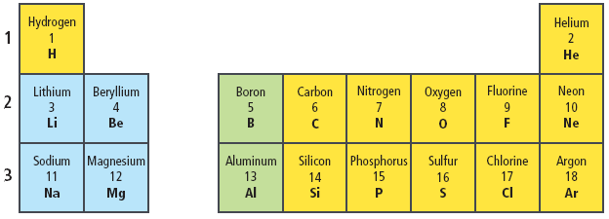
Standardized Test Practice
Question 4
How many electrons are needed to fill the inner energy level of fluorine?
A. 1
B. 2
C. 3
D. 4

Slide 29
Standardized Test Practice
Answer
The answer is A. Fluorine has 9 electrons, 2 in energy level one and 7 in energy level two.

Slide 30
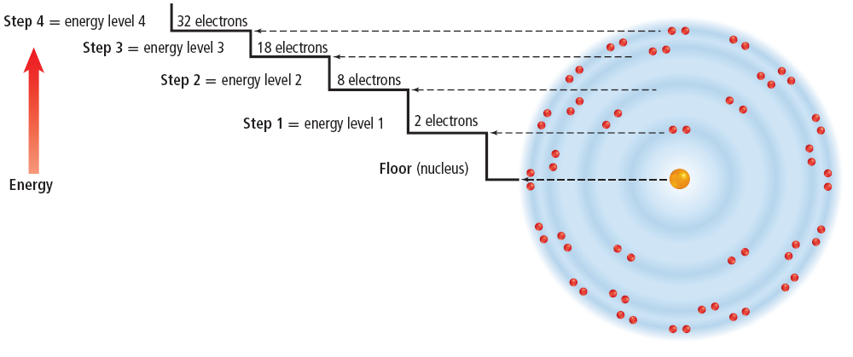
Standardized Test Practice
Question 5
Based on this diagram, which would you expect to be most stable?

Slide 31
Standardized Test Practice
A. hydrogen, atomic number 1
B. helium, atomic number 2
C. sodium, atomic number 11
D. chlorine, atomic number 17

Slide 32
Standardized Test Practice
Answer
The answer is B. Helium has a complete outer energy level and is relatively unreactive.

