Slide 1
Biological Polymers
Biological polymers are made of many smaller monomers that are linked together.
Many of the important biological compounds in your body are polymers.
Among them are the proteins, which often contain hundreds of units.
The monomers of biological polymers are usually larger and more complex in structure than other monomers.

Slide 2
Proteins
Proteins are large organic polymers formed from organic monomers called amino acids.
Even though only 20 amino acids are commonly found in nature, they can be arranged in so many ways that millions of different proteins exist.

Slide 3
Proteins
Proteins come in numerous forms and make up many of the tissues in your body, such as muscles and tendons, as well as your hair and fingernails.
In fact, proteins account for 15 percent of your total body weight.

Slide 4
Protein Monomers
Amino acids, such as glycine and cysteine, has an amine group (-NH₂) and a carboxylic acid group
(-COOH).
Amine groups of one amino acid can combine with the carboxylic acid group of another amino acid, linking them together to form a compound called a peptide.

Slide 5
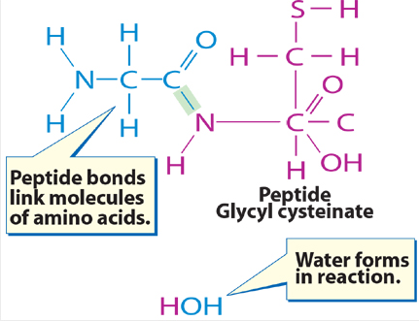
Protein Monomers
The bond joining them is known as peptide bond.
When a peptide contains a large number of amino acids—about 50 or more—the molecule is called a protein.

Slide 6
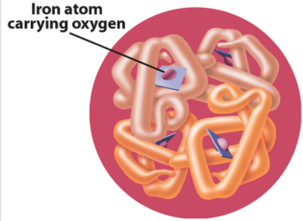
Protein Structure
Long protein molecules tend to twist and coil in a manner unique to each protein.
For example, hemoglobin, which carries oxygen in your blood, has four chains that coil around each other.

Slide 7
Protein Structure
Each chain contains an iron atom that carries the oxygen.
If you look closely, you can see all four iron atoms in hemoglobin.

Slide 8
Protein Structure
When you eat foods that contain proteins, your body breaks down the proteins into their amino acid monomers.
Then your body uses these amino acids to make new proteins that form muscles, blood, and other body tissues.

Slide 9
Carbohydrates
Carbohydrates are compounds containing carbon, hydrogen, and oxygen, which have twice as many hydrogen atoms as oxygen atoms.
Carbohydrates include the sugars and starches.

Slide 10
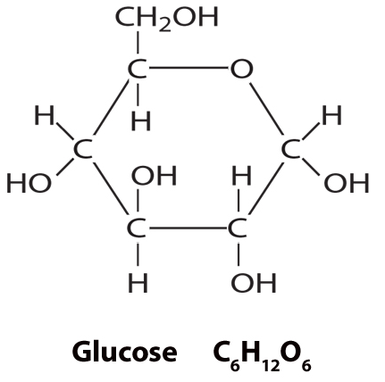
Sugars
Sugars are a major group of carbohydrates.
The sugar glucose is found in your blood and also in many sweet foods such as grapes and honey.

Slide 11
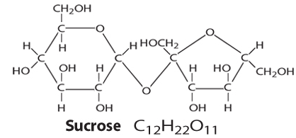
Sugars
Common table sugar, known as sucrose, is broken down by digestion into two simpler sugars—fructose, often called fruit sugar, and glucose.
Unlike starches, sugars provide quick energy soon after eating.

Slide 12
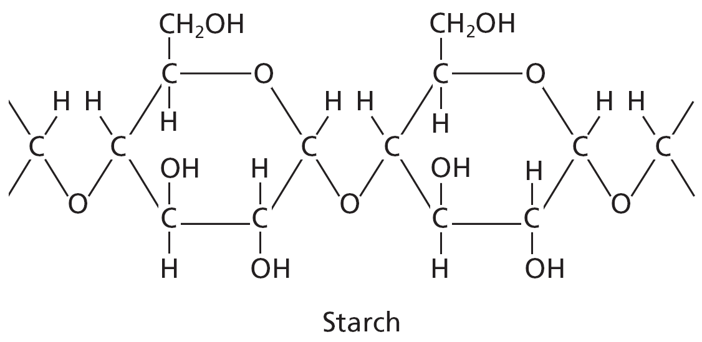
Starches
Starches are another type of carbohydrate.
Starches are polymers made of sugar monomers.
This starch is made of glucose monomers.

Slide 13
Starches
The energy from starches can be stored in liver and muscle cells in the form of a compound called glycogen.
During a long race, this stored energy is released, giving the athlete a fresh burst of power.

Slide 14
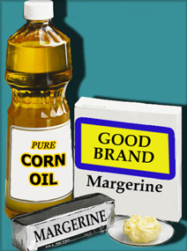
Lipids
Fats, oils, and related compounds make up a group of organic compounds known as lipids.
Lipids contain the same elements as carbohydrates but in different proportions.

Slide 15
Lipids
Lipids have fewer oxygen atoms and contain carboxylic acid groups.
Fats and oils are similar in structure to hydrocarbons.

Slide 16
Fats and Oils
They can be classified as saturated or unsaturated, according to the types of bonds in their carbon chains.
Saturated fats contain only single bonds between carbon atoms.
Unsaturated fats having one double bond are called monounsaturated, and those having two or more double bonds are called polyunsaturated.

Slide 17
Fats and Oils
Animal lipids or fats tend to be saturated and are solids at room temperature.
Plant lipids called oils are unsaturated and are usually liquids.

Slide 18
Fats and Oils
Evidence shows that too much saturated fat and cholesterol in the diet may contribute to some heart disease and that unsaturated fats may help to prevent heart disease.
A balanced diet includes some fats, just as it includes proteins and carbohydrates.

Slide 19
Nucleic Acids
A nucleic acid is an organic polymer that controls the activity and reproduction of cells.
One kind of nucleic acid, called deoxyribonucleic (dee AHK sih ri boh noo klah ihk) acid or DNA, is found in the nuclei of cells where it codes and stores genetic information.
This is known as the genetic code.

Slide 20
Nucleic Acid Monomers
The monomers that make up DNA are called nucleotides.
Nucleotides are complex molecules containing an organic base, a sugar, and a phosphoric acid unit.

Slide 21
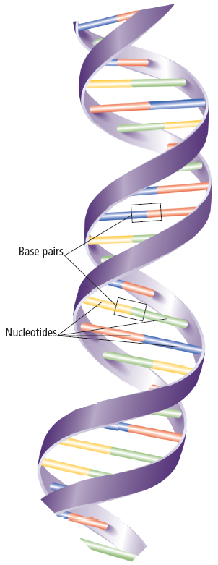
Nucleic Acid Monomers
In DNA two nucleotide chains twist around each other forming what resembles a twisted ladder or what is called the double helix.

Slide 22
Nucleic Acid Monomers
Human DNA contains only four different organic bases, but they can form millions of combinations.
The bases on one side of the ladder pair with bases on the other side.

Slide 23
DNA Fingerprinting
The DNA of each person differs in some way from that of everyone else, except for identical twins, who share the same DNA sequence.
The unique nature of DNA offers crime investigators a way to identify criminals from hair or fluids left at a crime scene.

Slide 24
DNA Fingerprinting
Chemists can break up the DNA into its nucleotide components and use radioactive and X-ray methods to obtain a picture of the nucleotide pattern.
Comparing this pattern to one made from the DNA of a suspect can link that suspect to the crime scene.

Slide 25
Section Check
Question 1
Proteins are large organic polymers formed from __________.
A. glucose
B. amino acids
C. carboxylic acids
D. nucleic acids

Slide 26
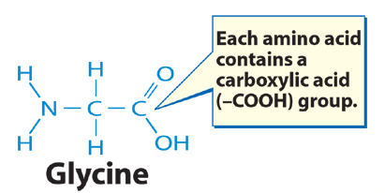
Section Check
Answer
The answer is B, amino acids. Every amino acid contains a carboxylic acid group, as well as an amine group.

Slide 27
Section Check
Question 2
Which of the following refers specifically to the bond linking amino acids?
A. ionic
B. covalent
C. metallic
D. peptide

Slide 28
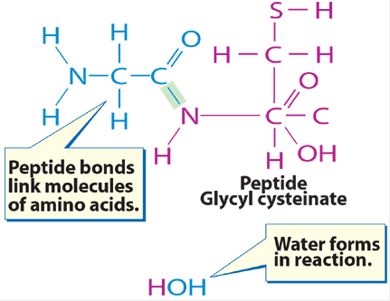
Section Check
Answer
The answer is D. Peptides are compounds formed by the linking together of amino acids

Slide 29
Section Check
Question 3
What part of a nucleic acid monomer forms the “rungs” of a DNA ladder?

Slide 30
Section Check
Answer
The four different organic bases in DNA form hydrogen bonds and make up the “rungs” of the ladder. The sugar and phosphate groups make up the backbone, or sides of the ladder.

