Slide 1
What is petroleum?
What is petroleum?
Do you carry a comb in your pocket or purse? What is it made from?

Slide 2
What is petroleum?
Petroleum is a fossil fuel that is a mixture of thousands of carbon compounds.
The liquid part of petroleum is called crude oil.
Crude oil is dark, flammable, and foul-smelling.

Slide 3
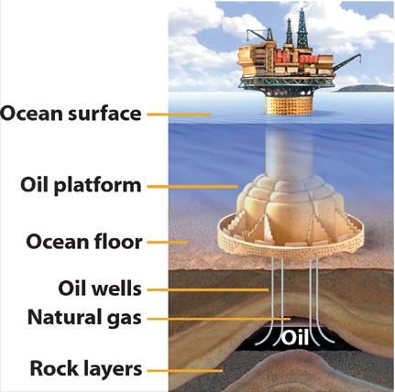
Processing Crude Oil
To make items such as combs, the first step is to extract the crude oil from its underground source.

Slide 4
Processing Crude Oil
Then, chemists and engineers separate the crude oil into fractions containing compounds with similar boiling points.
The separation process is known as fractional distillation.

Slide 5
What is petroleum?
If you have ever driven past a refinery, you may have seen big, metal towers called fractionating towers.
They often rise as high as 35 m and can be 18 m wide and have pipes and metal scaffolding attached to the outside.

Slide 6
The Tower
Inside the tower is a series of metal plates arranged like the floors of a building.
These plates have small holes so that vapors can pass through.

Slide 7
The Tower
The tower separates crude oil into fractions containing compounds having a range of boiling points.
Within a fraction, boiling points may range more than 100°C.

Slide 8
Separating Fractions
The crude petroleum at the base of the tower is heated to more than 350°C.
At this temperature most hydrocarbons in the mixture become vapor and start to rise.

Slide 9
Separating Fractions
The higher boiling fractions reach only the lower plates before they condense, forming shallow pools that drain off through pipes on the sides of the tower and are collected.
Fractions with lower boiling points may climb higher to the middle plates before condensing.

Slide 10
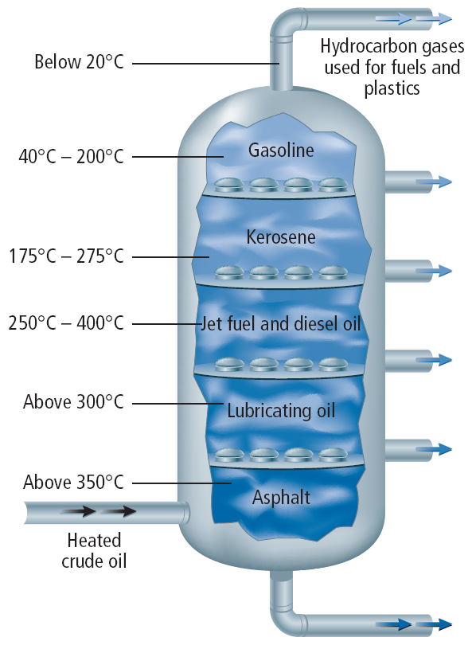
Separating Fractions
Finally, those with the lowest boiling points condense on the top most plates or never condense at all and are collected as gasses at the top of the tower.

Slide 11
Separating Fractions
Why don’t the condensed liquids fall back through the holes?
The reason is that pressure from the rising vapors prevents this.
The separation of the fractions is improved by the interaction of rising vapors with condensed liquid.

Slide 12
Uses for Petroleum Compounds
The fractions that condense on the upper plates and contain from five to ten carbons are used for gasoline and solvents.

Slide 13
Uses for Petroleum Compounds
Below these are fractions with 12 to 18 carbons that are used for kerosene and jet fuel.
The bottom fractions go into lubricating oil, and the residue is used for paving asphalt.

Slide 14
Other Petroleum Products
Aromatic dyes from petroleum have replaced natural dyes, such as indigo and alizarin, almost completely.
The first synthetic dye was a bright purple called mauve that was discovered accidentally in coal tar compounds.

Slide 15
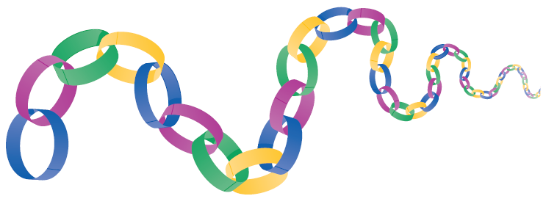
Polymers
Did you ever loop together strips of paper to make paper chains for decorations?
A paper chain can represent the structure of a polymer.
Some of the smaller molecules from petroleum can act like links in a chain.

Slide 16
Polymers
Long chains of monomers are called polymers.
The small molecule, which can combine with itself repeatedly to form long chain, is called a monomer.
Often two or more different monomers, known as copolymers, combine to make one polymer molecule.

Slide 17
Polymer Properties
Polymers can be made light and flexible or so strong that they can be used to make plastic pipes, boats, and even some auto bodies.
Because so many things used today are made of synthetic polymers, some people call this "The Age of Plastics."

Slide 18
Polymer Properties
The properties of polymers depend mostly on which monomers are used to make them.
Like hydrocarbons, polymers can have branches in their chains.
The amount of branching and the shape of the polymer greatly affects its properties.

Slide 19
Polymer Properties
Other polymers can be spun into threads, which are used to make clothing or items such as suitcases and backpacks.
Bulletproof vests are made of tightly woven, synthetic polymer.
Some polymers remain rigid when heated, but others become soft and pliable when heated and harden again when cooled.

Slide 20
Hydrocarbon Polymers
Some polymers are made from only carbon and hydrogen.
One common polymer or plastic is made from the monomer ethene or ethylene.
Under standard room-temperature conditions, this small hydrocarbon is a gas.
However, when ethylene combines with itself repeatedly, it forms a polymer called polyethylene.

Slide 21
Common Polymers
However, when ethylene combines with itself repeatedly it forms a polymer called polyethylene.
Polyethylene (pah lee EH thuh leen) is used widely in shopping bags and plastic bottles.

Slide 22
Hydrocarbon Polymers
Polypropylene is a hydrocarbon polymer made from propene monomers.
Polypropylene is used to make glues, carpets, and high-performance outdoor clothing.

Slide 23
Hydrocarbon Polymers
Sometimes the same polymer can take two completely different forms.
For example, polystyrene (pah lee STI reen) that is made from styrene, forms brittle, transparent cases for CDs and lightweight, opaque foam cups and packing materials.

Slide 24
Substituted Hydrocarbon Polymers
Polymers can contain elements besides carbon and hydrogen.
For example, polyurethane contains carbon, hydrogen, nitrogen, and oxygen.
Polyurethane is used to make synthetic sponges, foam, waterproof coatings, and shoe parts.

Slide 25
Substituted Hydrocarbon Polymers
Another substituted hydrocarbon polymer is polyvinyl chloride (PVC).
In PVC, some of the hydrogen atoms are replaced with chlorine atoms.
PVC is used to make plastic pipes, house siding, and hoses.

Slide 26
Polyesters
Synthetic fibers known as polyesters are polymers; that is, they are chains containing many or poly esters.
They are made from an organic acid that has two –COOH groups and an alcohol that has two –OH groups, as shown.

Slide 27
Polyesters
Many varieties of polyesters can be made, depending on what alcohols and acids are used.
Polyesters are often used to make fabrics that are durable, water-repellant, colorfast, and do not wrinkle easily.

Slide 28
Hydrocarbon Polymers
To make this transformation, a gas such as carbon dioxide is blown into melted polystyrene as it is molded.
Bubbles remain within the polymer when it cools, making polystyrene foam an efficient insulator.

Slide 29
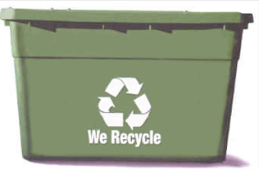
Depolymerization
Many polymers do not decompose.
One way to combat this is by recycling, which recovers clean plastics for reuse in new products.

Slide 30
Depolymerization
Another approach involves a process called depolymerization, which uses heat or chemicals to break the long polymer chain into its monomer fragments.
These monomers can then be reused.
Each polymer requires a different process, and much research is needed to make this type of recycling economical.

Slide 31
Section Check
Question 1
Petroleum is a mixture of thousands of __________ compounds.
A. iron
B. hydrogen
C. carbon
D. nitrogen

Slide 32
Section Check
Answer
The answer is C. Petroleum contains the flammable liquid called crude oil.

Slide 33
Section Check
Question 2
What process is used to separate crude oil into useable compounds?

Slide 34
Section Check
Answer
Fractional distillation is used to separate crude oil into fractions containing compounds with similar boiling points. This process takes place in petroleum refineries.

Slide 35
Section Check
Question 3
Which is not obtained from petroleum?
A. propane
B. gasoline
C. paving asphalt
D. glycogen

Slide 36
Section Check
Answer
The answer is D. Glycogen is a glucose polymer that stores energy from starch in the liver and muscles.

