Slide 1
Substituted Hydrocarbons
A substituted hydrocarbon has one or more of its hydrogen atoms replaced by atoms or groups of other elements.
The group of atoms inserted are called functional groups.
Depending on what properties are needed, chemists decide what to add.

Slide 2
Substituting Oxygen Groups
Oxygen is found in many substituted hydrocarbons.
Oxygen can form single and double bonds with carbon, and single bonds with hydrogen.
Alcohols, organic acids, and esters have functional groups that contain oxygen.

Slide 3
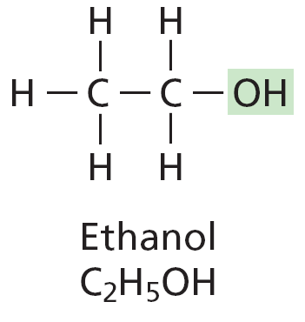
Alcohols and Acids
An alcohol is formed when –OH groups replace one or more hydrogen atoms in a hydrocarbon.
Organic acids form when a carboxyl group, –COOH, is substituted for one of the hydrogen atoms attached to a carbon atom.

Slide 4
Alcohols
Rubbing alcohol is a substituted hydrocarbon.
Alcohols are an important group of organic compounds.
They serve often as solvents and disinfectants, and more importantly can be used as pieces to assemble larger molecules.

Slide 5
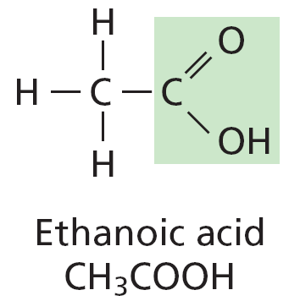
Organic Acids
The structures of ethane, ethanol, and ethanoic acid are similar.
Do you see that ethanoic acid, found in vinegar, is substituted hydrocarbon?

Slide 6
Esters
Mixing an acid and a base will yield water and a salt.
Similarly, mixed an alcohol and an organic acid will yield water and an ester.
Substituted hydrocarbons that contain a –COOC group are called esters.

Slide 7
Esters
Esters of the alcohol glycerine are used commercially to make soaps.
Other esters are used widely in flavors and perfumes, and still others can be transformed into fibers to make clothing.

Slide 8
Esters for Flavor
Many fruit-flavored soft drinks and desserts taste like the real fruit.
If you look at the label though, you might be surprised to find that no fruit was used⎯only artificial flavor.
Most likely this artificial flavor contains some esters.

Slide 9
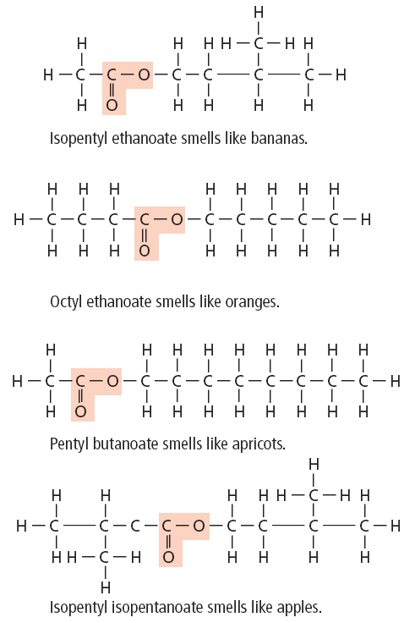
Esters for Flavor
Although natural and artificial flavors often contain a blend of many esters, the odor of some individual esters immediately makes you think of particular fruits as shown.

Slide 10
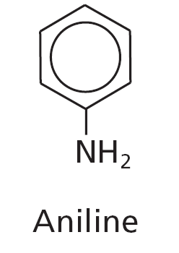
Amines
Amines are substituted hydrocarbons that have –SH group replacing a hydrogen atom.
Aniline is an amine that is used to make dyes.
Amines are also essential for life.

Slide 11
Mercaptans
When a –SH group replaces a hydrogen atom, the resulting compound is called a thiol, or more commonly a mercaptan.
Most mercaptans have unpleasant odors. This can be useful to animals like the skunk.

Slide 12
Mercaptans
Though you might not think so, such a powerful stink can be an asset, and not just for skunks.
In fact, smelly mercaptans can save lives.
Natural gas has no odor, so gas companies add small amounts of mercaptans so the people can detect gas leaks.

Slide 13
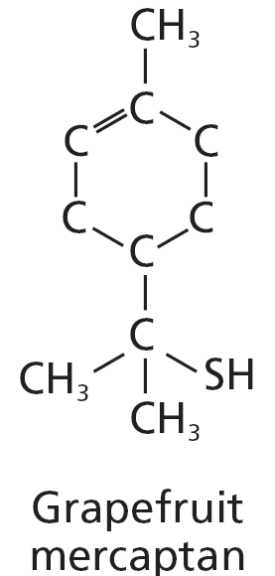
Mercaptans
Small amounts of some mercaptans, however, can produce pleasant smells.
For example, the grapefruit mercaptan give grapefruit its distinct smell and flavor.

Slide 14
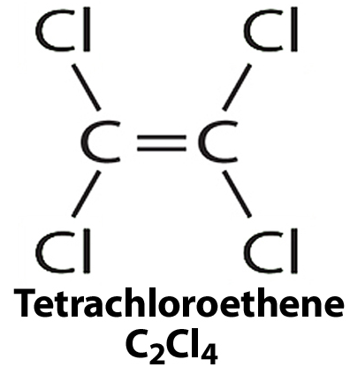
Halocarbons
When four chlorine atoms replace four hydrogen atoms in ethylene, the result is tetrachloroethene (the truh klor uh eth EEN).

Slide 15
Substituting Other Elements
Adding four fluorine atoms to ethylene makes a compound that can be transformed into a black, shiny material used for nonstick surfaces in cookware.
When one or more hydrogen atoms are replaced with a halogen, such as chlorine or fluorine, the result is a halocarbon.

Slide 16
Aromatic Compounds
Chewing flavored gum or dissolving a candy mint in your mouth releases pleasant flavors and aromas.
Many chemical compounds produce pleasant odors but others have less pleasant flavors and smells.

Slide 17
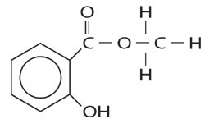
Aromatic Compounds
Smell is not what makes a compound aromatic in the chemical sense.
To a chemist, an aromatic compound is one that contains a benzene structure.

Slide 18
Section Check
Question 1
What is an aromatic compound?

Slide 19
Section Check
Answer
In the chemical sense, an aromatic compound is one that contains a benzene structure having a ring with six carbons.

Slide 20
Section Check
Question 2
A –NH₂ group takes the place of a hydrogen atom in a (n) __________.
ester
halocarbon
mercaptan
amine

Slide 21
Section Check
Answer
The answer is D. Amines contain a –NH₂ group.

Slide 22
Section Check
Question 3
If a hydroxyl (-OH) group replaces a hydrogen atom in a hydrocarbon, what type of compound results?

Slide 23
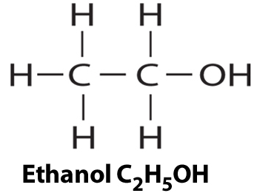
Section Check
Answer
An alcohol is formed when
-OH groups replace one or more hydrogen atoms in a hydrocarbon.

