Slide 1
Organic Compounds
Most compounds containing the element carbon are organic compounds.
The others, including carbon dioxide and the carbonates, are considered inorganic.

Slide 2
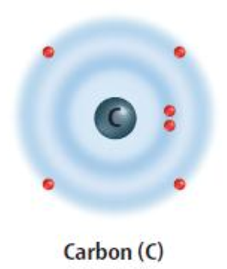
Bonding
You may wonder why carbon can form so many organic compounds.
The main reason is that a carbon atom has four electrons in its outer energy level.
This means that each carbon atom can form four covalent bonds with atoms of carbon or with other elements.

Slide 3
Bonding
A covalent bond is formed when two atoms share a pair of electrons.
This large number of bonds allows carbon to form many types of compounds ranging from small compounds to complex compounds.
It also can form double and triple bonds as well as single bonds.

Slide 4
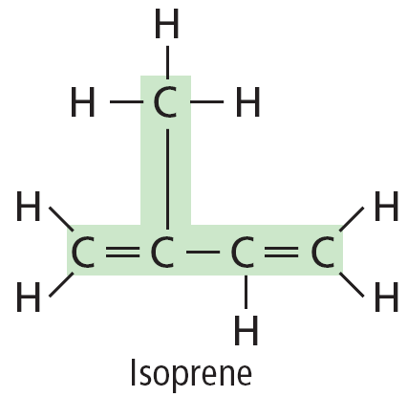
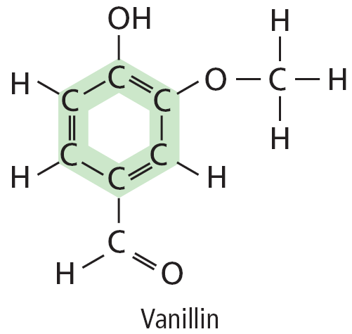
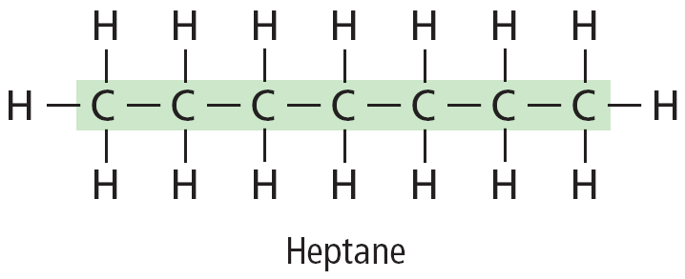
Arrangement
Another reason carbon can form so many compounds is that carbon can link together with other carbon atoms in many different arrangements—chains, branched chains, and even rings.

Slide 5
Representing Organic Compounds
There are many ways to represent organic compounds.
Three common ways are the chemical formula, the structural formula, and the space-filling model.
For example, methane can be represented by its chemical formula CH₄.

Slide 6
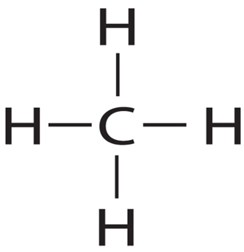
Representations
Methane can be represented in two other ways.
The structural formula uses lines to show that four hydrogen atoms are bonded to one carbon atom in a methane molecule.

Slide 7
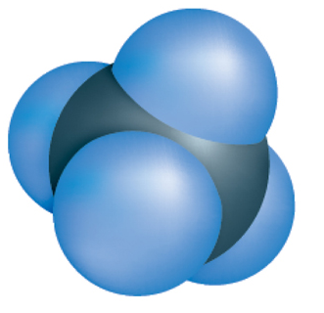
Representations
The second way, the space-filling model, shows a more realistic picture of the relative size and arrangement of the atoms in the molecule.

Slide 8
Hydrocarbons
Methane is a main component of natural gas and is a hydrocarbon.
A compound made up of only carbon and hydrogen atoms is called a hydrocarbon.
Methane and other hydrocarbons produce more than 90 percent of the energy humans use.

Slide 9
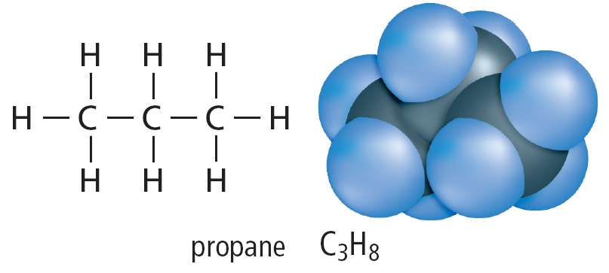
Hydrocarbons
Another hydrocarbon used as fuel is propane.
Propane's structural formula and space-filling model are shown.

Slide 10
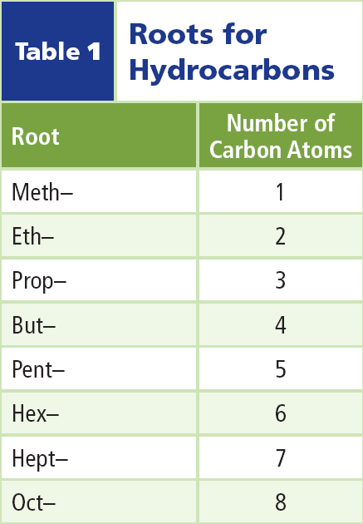
Hydrocarbon Lengths
Hydrocarbon chains come in many lengths.
The root of the hydrocarbon’s name tells you how many carbon atoms are in the chain.
This table lists the roots for some hydrocarbons.

Slide 11
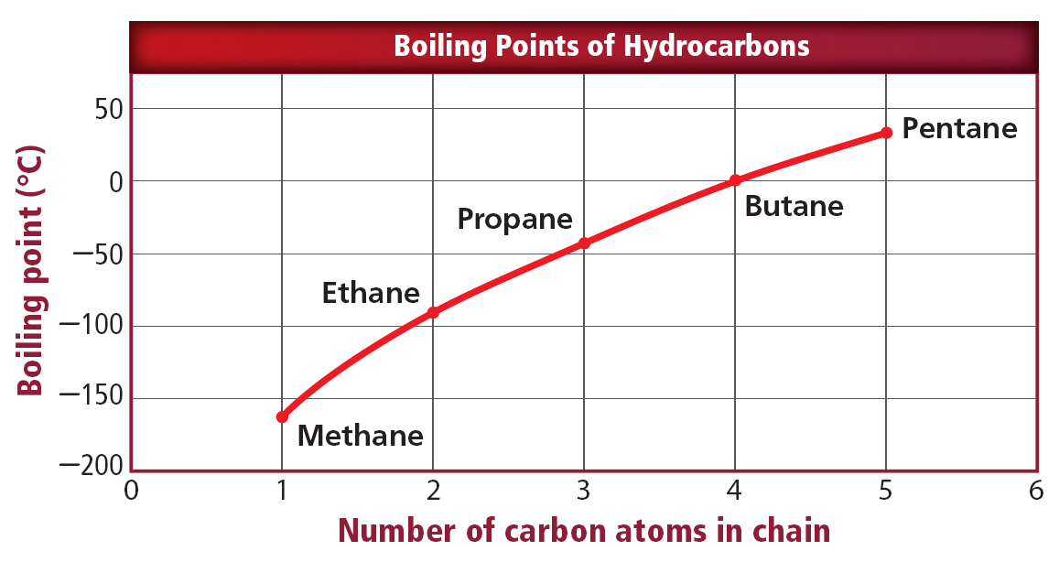
Hydrocarbon Lengths
This figure shows a graph of the boiling points of some hydrocarbons.
Notice the relationship between boiling points and the addition of carbon atoms.

Slide 12
Bonding in Hydrocarbons
An easy way to remember what type of bond a hydrocarbon has is to look at the last three letters.
Compounds ending with -ane have a single bond; the ending -ene indicates a double bond, and -yne indicates a triple bond.

Slide 13
Single Bonds
Hydrocarbons that contain only single bonds are called saturated hydrocarbons.
The table lists four saturated hydrocarbons.
Notice how each carbon atom appears to be a link in a chain connected by single covalent bonds.

Slide 14
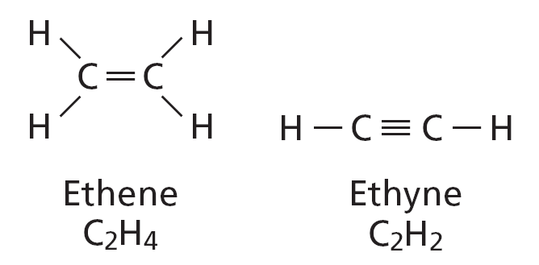
Multiple Bonds
Hydrocarbons, such as ethene and ethyne, that contain at least one double or triple bond are called unsaturated hydrocarbons.

Slide 15
Multiple Bonds
Ethylene is another name for the hydrocarbon ethene, (C₂H₄).
This contains one double bone in which two carbon atoms share two pairs of electrons.
The hydrocarbon ethyne (C₂H₂) contains a triple bond in which three pairs of electrons are shared.

Slide 16
Structural Isomers
The chemical formula of pentane is C₅H₁₂.
Two other hydrocarbon called isopentane and neopentane have exactly the same chemical formula.
How can this be?

Slide 17
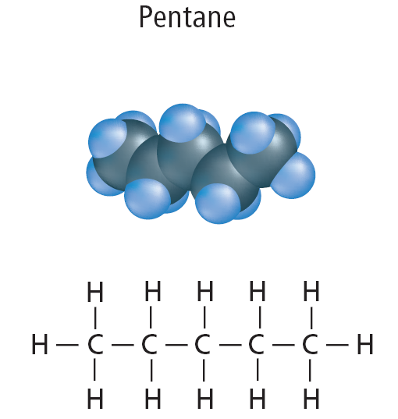
Structural Isomers
The answer lies in the arrangement of the five carbon atoms.
In a molecule of pentane, the carbon atoms form a continuous chain.

Slide 18
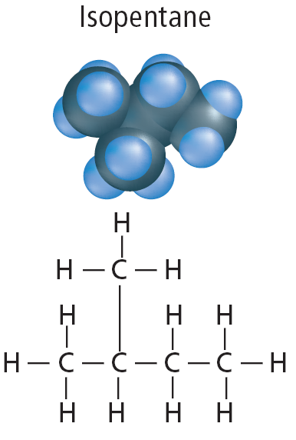
Structural Isomers
The carbon chain of iospentane has one branch and the chain of neopentane has two branches.

Slide 19
Structural Isomers
Pentane, isopentane, and neopentane are isomers.
Isomers are compounds that have identical chemical formulas but different molecular structures and shapes.
Click image to play movie

Slide 20
Properties of Isomers
The arrangement of carbon atoms in each compound changes the shape of the molecule, and very often affects its physical properties.
Generally, melting points and boiling points are lowered as the amount of branching in an isomer increases.

Slide 21
Properties of Isomers
You can see this pattern in the table.

Slide 22
Properties of Isomers
You may have noticed that the melting point of neopentane does not follow the general trend.
Its higher melting point is due to its symmetry and globular shape.

Slide 23
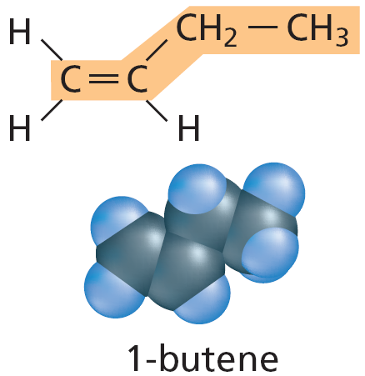
Other Isomers
There are many other kinds of isomers.
In unsaturated hydrocarbons, the double and triple bonds can be located in different places in a carbon chain.
For example, in this butene isomer (called 1-butene), the double bond is between the first and second carbon atoms.

Slide 24
Other Isomers
In these butene isomers, the double bond is between the second and third carbons.
Notice that there are two ways that the chain can bend when the double bond is in this location.

Slide 25
Other Isomers
Some isomers differ only slightly in how their atoms are arranged in space.
Such isomers form what is often called right- and left-handed molecules, like mirror images.
Two such isomers may have nearly identical physical and chemical properties.

Slide 26
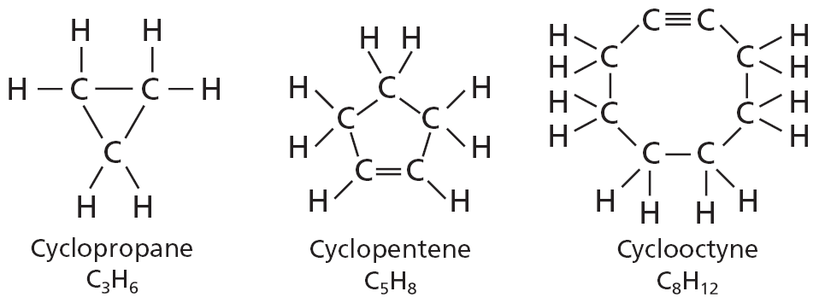
Carbon Rings
Carbon chains can also form rings. These rings are often referred to as cyclic compounds
Carbon rings are indicated by the prefix cyclo-, which means circular.
Three cyclic compoundscyclopropane, cyclopentene, and cycloctyneare shown here.

Slide 27
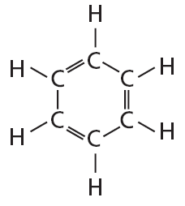
Benzene
Look at a model of benzene, C₆H₆, and its structural formula.
As you can see, the benzene molecule has six carbon atoms bonded into a ring with alternating double and single bonds.

Slide 28
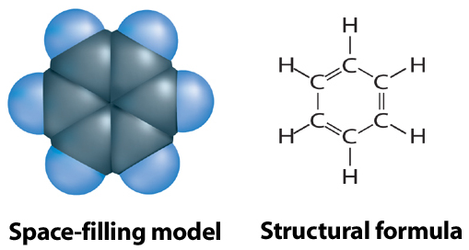
Benzene
The electrons shown as alternating double and single bonds that form the ring are shared by all six carbon atoms in the ring.

Slide 29
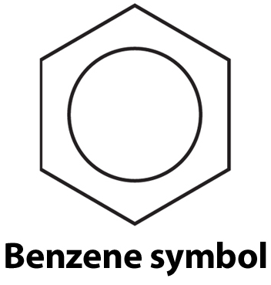
Benzene
This equal sharing of electrons is represented by the special benzene symbol—a circle in a hexagon.
Many compounds contain this stable ring structure.
The stable ring acts as a framework upon which new molecules can be built.

Slide 30
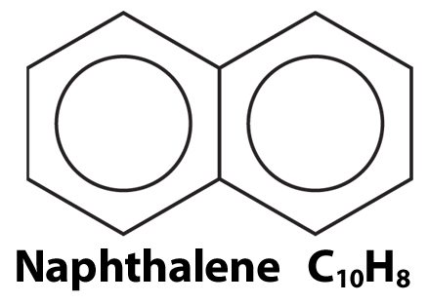
Fused Rings
Benzene rings sometimes fuse together.
One type of moth crystal is made of naphthalene (NAF thuh leen), which is two fused benzene rings.

Slide 31
Fused Rings
Many known compounds contain three or more rings fused together.
Tetracycline (teh truh SI kleen) antibiotics are based on a fused ring system containing four fused rings.

Slide 32
Section Check
Question 1
What element must a compound contain in order to be considered an organic compound?
A. carbon
B. nitrogen
C. oxygen
D. hydrogen

Slide 33
Section Check
Answer
The answer is A. Most compounds containing carbon are organic compounds.

Slide 34
Section Check
Question 2
Which is a hydrocarbon?
A. propane
B. ethanol
C. acetic acid
D. mercaptan

Slide 35
Section Check
Answer
Propane is a hydrocarbon, made up of only carbon and hydrogen atoms.

Slide 36
Section Check
Question 3
Hydrocarbons containing only single-bonded carbon atoms are called __________.

Slide 37
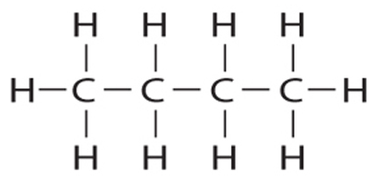
Section Check
Answer
They are called saturated hydrocarbons. “Saturated” in this term means the compound holds as many hydrogen atoms as possible.

