Slide 1
Reviewing Main Ideas
Stability in Bonding
The properties of compounds are generally different from the properties of the elements they contain.
A chemical formula for a compound indicates the composition of a unit of the compound.

Slide 2
Reviewing Main Ideas
Stability in Bonding
Chemical bonding occurs because atoms of most elements become more stable by gaining, losing, or sharing electrons in order to obtain a stable outer energy level.

Slide 3
Reviewing Main Ideas
Types of Bonds
Ionic bonds between atoms are formed by the attraction between ions. Covalent bonds are formed by the sharing of electrons.
Ionic bonding occurs between charged particles called ions and produces ionic compounds. Covalent bonding produces units called molecules and occurs between nonmetallic elements.

Slide 4
Reviewing Main Ideas
Types of Bonds
The unequal sharing of electrons produces compounds that contain polar bonds, and the equal sharing of electrons produces nonpolar compounds.

Slide 5
Reviewing Main Ideas
Writing Formulas and Naming Compounds
An oxidation number indicates how many electrons an atom has gained, lost, or shared when bonding with other atoms.
In the formula of an ionic compound, the element or ion with the positive oxidation number is written first, followed by the one with the negative oxidation number.

Slide 6
Reviewing Main Ideas
Writing Formulas and Naming Compounds
The name of a binary compound is derived from the names of the two elements that compose the compound. Salt is an example of a binary compound.
A hydrate is a compound that has water chemically attached to its ions and written into its formula.

Slide 7
Reviewing Main Ideas
Writing Formulas and Naming Compounds
Greek prefixes are used in the names of covalent compounds. These indicate the number of each atom present.

Slide 8
Chapter Review
Question 1
What are the three ways atoms form chemical bonds?

Slide 9
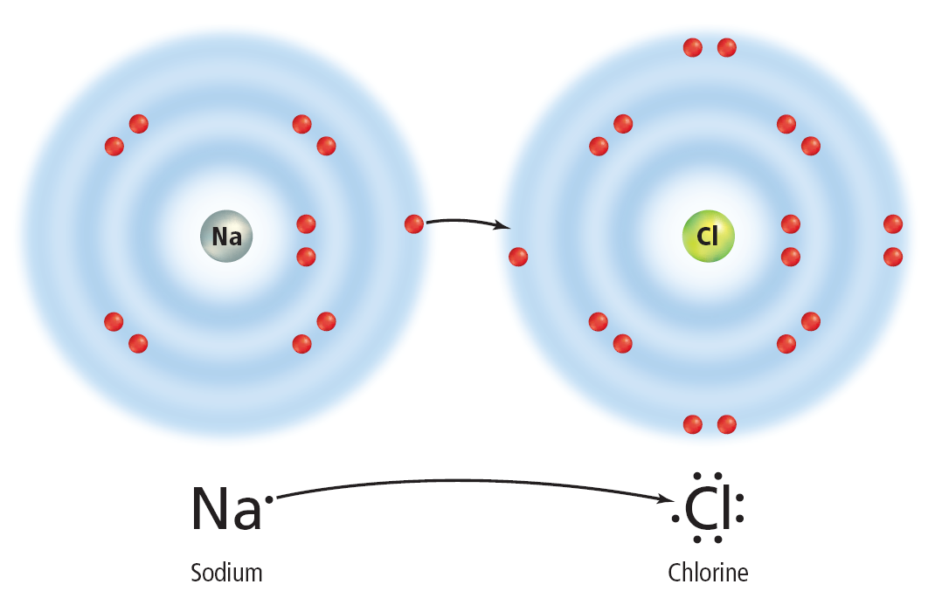
Chapter Review
Answer
Atoms can gain, share, or lose electrons in order to form the chemical bonds of compounds.

Slide 10
Chapter Review
Question 2
Which type of bond exists in this molecule?

Slide 11
Chapter Review
Answer
This is a water molecule containing two single covalent bonds, one between each hydrogen atom and the oxygen atom.

Slide 12
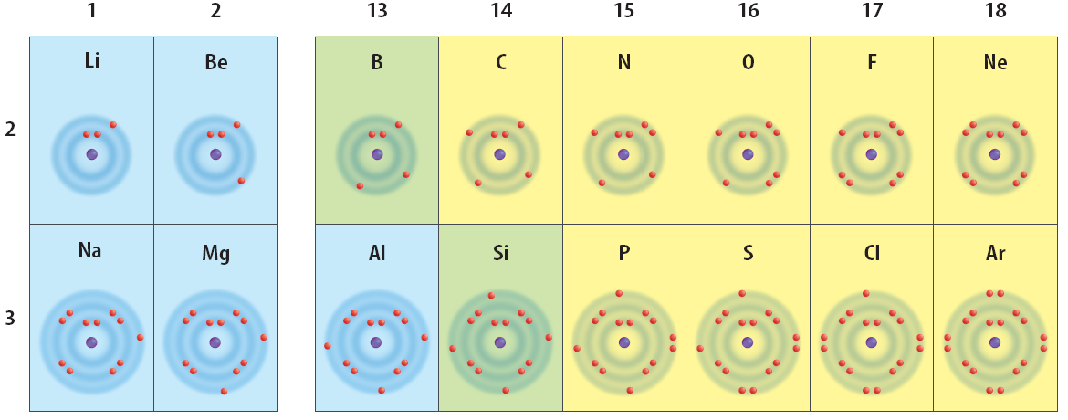
Chapter Review
Question 3
Which are more likely to form an ionic bond, sodium and fluorine or lithium and carbon?

Slide 13
Chapter Review
Answer
Sodium and fluorine are most likely to form an ionic bond because sodium has one electron in its outer energy level; fluorine has seven electrons in its outer energy level.

Slide 14
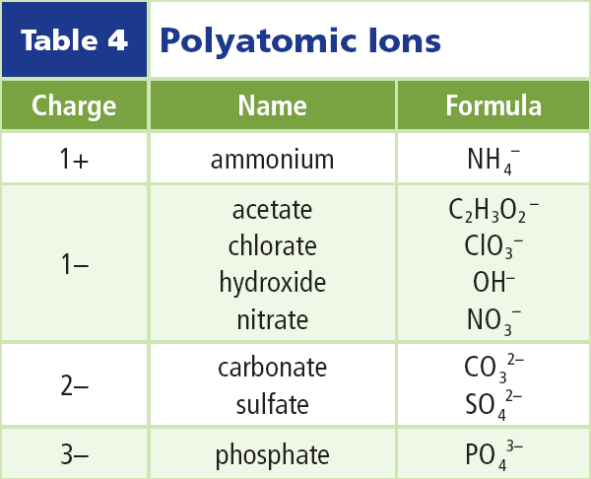
Chapter Review
Question 4
What is the chemical formula for ammonium hydroxide?
A. NH₄OH
B. (NH₄)₂OH
C. NH₄(OH)₂
D. NHOH

Slide 15
Chapter Review
Answer
The answer is A. The ammonium and hydroxide ions have 1+ and 1- charges, respectively.

Slide 16
Chapter Review
Question 5
What is the name of Cu₃(PO₄)₂?
A. copper phosphide
B. copper (III) phosphate
C. copper (II) phosphate
D. copper (II) phosphide

Slide 17
Chapter Review
Answer
The answer is C. The phosphate ion has a charge of 3-, and there are two of them. Since there are 3 copper atoms balancing the 6- charge, it must be copper(II) in this compound.

Slide 18
Standardized Test Practice
Question 1
How many oxygen atoms are needed for each molecule of carbon dioxide?
A. 1
B. 2
C. 3
D. 4

Slide 19
Standardized Test Practice
Answer
The answer is B. The formula for carbon dioxide is CO₂.

Slide 20
Standardized Test Practice
Question 2
Compare the atoms in group 17 to those in group 18. Which of these statements best describes these groups?

Slide 21
Standardized Test Practice
A. Group 18 is more stable than group 17.
B. Group 17 is more stable than group 18.

Slide 22
Standardized Test Practice
C. Group 17 and group 18 are both highly reactive.
D. Group 17 and group 18 are both stable.

Slide 23
Standardized Test Practice
Answer
The answer is A. Group 18 contains the noble gases, which have completely filled outer energy levels. They are unusually stable.

Slide 24
Standardized Test Practice
Question 3
Atoms in which group are most likely to form chemical bonds with atoms in group 17?

Slide 25
Standardized Test Practice
A. group 1
B. group 2
C. group 16
D. group 18

Slide 26
Standardized Test Practice
Answer
The answer is A. Elements in group 1 have one electron in their outer energy levels; group 17 elements need only one electron to complete their outer energy levels.

Slide 27
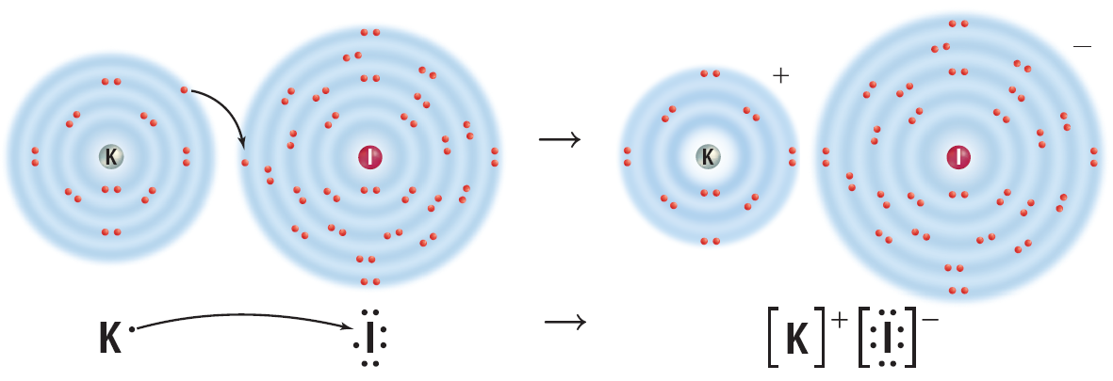
Standardized Test Practice
Question 4
What type of bond is represented in the diagram?
A. covalent
B. ionic
C. irreversible
D. transferable

Slide 28
Standardized Test Practice
Answer
The answer is B. In this ionic bond, a potassium atom loses one electron and an iodine atom gains one electron.

Slide 29
Standardized Test Practice
Question 4
What is the chemical formula for ammonium sulfate?
A. NH₄SO₄
B. (NH₄)₂SO₄
C. NH₄(SO₄)₂
D. (NH₄)₂(SO₄)₂

Slide 30
Standardized Test Practice
Answer
The answer is B. The ammonium ion has a positive charge of 1+; the sulfate ion has a charge of 2-. Two ammonium ions are required to balance the charge of the sulfate ion.

