Slide 1
Binary Ionic Compounds
The first formulas of compounds you will write are for binary ionic compounds.
A binary compound is one that is composed of two elements.
Before you can write a formula, you must have all the needed information at your fingertips.

Slide 2
Binary Ionic Compounds
You need to know which elements are involved and what number of electrons they lose, gain, or share in order to become stable.
The relationship between an element’s position on the periodic table and the number of electrons it gains or loses is called the oxidation number of an element.

Slide 3
Binary Ionic Compounds
An oxidation number tells you how many electrons an atom has gained, or shared, to become stable.
For ionic compounds, the oxidation number is the same as the charge on the ion.
For example, a sodium ion has a charge of 1+ and an oxidation number of 1+.

Slide 4
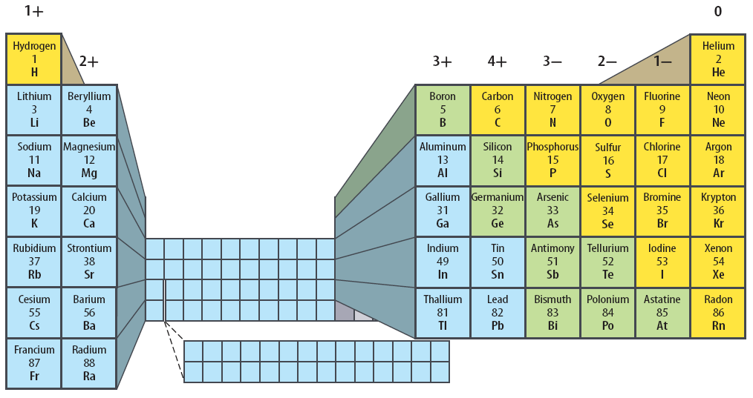
Oxidation Numbers
The number at the top of each column is the most common oxidation number of elements in that group.

Slide 5
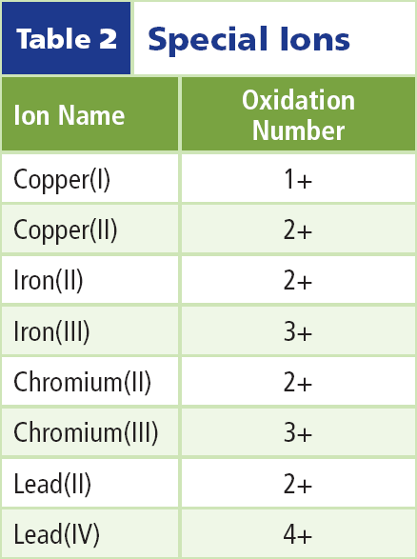
Oxidation Numbers
The elements in this table can have more than one oxidation number.
When naming these compounds, the oxidation number is expressed in the name with a roman numeral. For example, the oxidation number of iron in iron (III) oxide is 3+.

Slide 6
Compounds Are Neutral
When writing formulas, it is important to remember that although the individual ions in a compound carry charges, the compound itself is neutral.
A formula must have the right number of positive ions and the right number of negative ions so the charges balance.

Slide 7
Compounds Are Neutral
What if you have a compound like calcium fluoride?
A calcium ion has a charge of 2+ and a fluoride ion has a charge of 1 −.
In this case you need to have two fluoride ions for every calcium ion in order for the charges to cancel and the compound to be neutral with the formula CaF₂.

Slide 8
Writing Formulas
You can write formulas for ionic compounds by using the following rules in this order.
1. Write the symbol of the element or polyatomic ion (ions containing more than one atom) that has the positive oxidation number or charge.

Slide 9
Writing Formulas
2. Write the symbol of the element or polyatomic ion with the negative oxidation number.
3. The charge (without the sign) of one ion becomes the subscript of the other ion. Reduce the subscripts to the smallest whole numbers that retain the ratio of ions.

Slide 10
Writing Names
You can name a binary ionic compound from its formula by using these rules.
1. Write the name of the positive ion.

Slide 11
Writing Names
2. Check to see if the positive ion is capable of forming more than one oxidation number. If it is, determine the oxidation number of the ion from the formula of the compound.

Slide 12
Writing Names
2. (continued) Write the charge of the positive ion using roman numerals in parentheses after the ion’s name. If the ion has only one possible oxidation number, proceed to step 3.

Slide 13
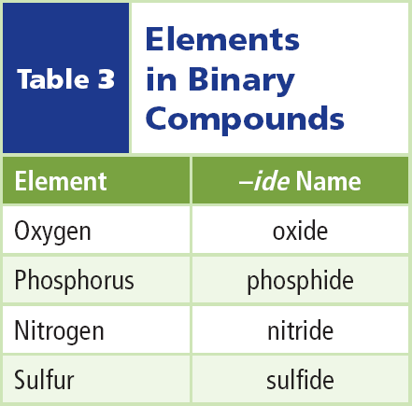
Writing Names
3. Write the root name of the negative ion. The root is the first part of the element’s name.
4. Add the ending -ide to the root. The table lists several elements and their -ide counterparts.

Slide 14
Writing Names
Subscripts do not become part of the name for ionic compounds.
However, subscripts can be used to help determine the charges of those metals that have more than one positive charge

Slide 15
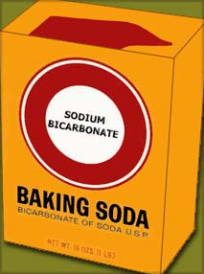
Compounds with Complex Ions
Not all ionic compounds are binary.
Baking soda has the formula NaHCO₃.
This is an example of an ionic compound that is not binary.

Slide 16
Compounds with Complex Ions
Some ionic compounds, including baking soda, are composed of more than two elements. They contain polyatomic ions.

Slide 17
Compounds with Complex Ions
A polyatomic ion is a positively or negatively charged, covalently bonded group of atoms.
So the polyatomic ions as a whole contain two or more elements.

Slide 18
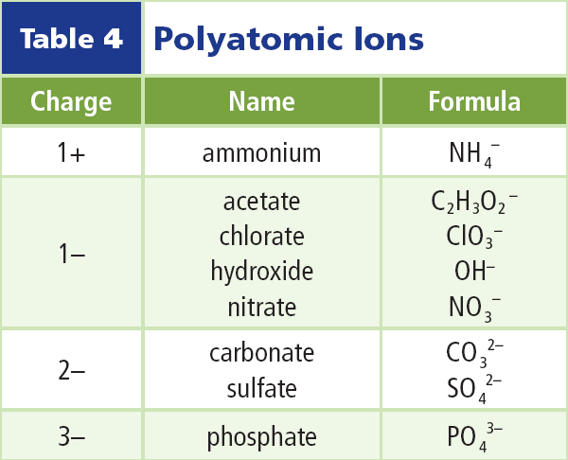
Writing Names
The table lists several polyatomic ions.
To name a compound that contains one of these ions, first write the name of the positive ion.
Then write the name of the negative ion.

Slide 19
Writing Formulas
To write formulas for these compounds, follow the rules for binary compounds, with one addition.
When more than one polyatomic ion is needed, write parentheses around the polyatomic ion before adding the subscript.

Slide 20
Writing Formulas
Here is one example of naming a complex compound.

Slide 21
Compounds with Added Water
Some ionic compounds have water molecules as part of their structure. These compounds are called hydrates.
A hydrate is a compound that has water chemically attached to its ions and written into its chemical formula.

Slide 22
Common Hydrates
When a solution of cobalt chloride evaporates, pink crystals that contain six water molecules for each unit of cobalt chloride are formed.
The formula for this compound is CoCl₂ • 6 H₂O.

Slide 23
Common Hydrates
Plaster of paris also forms a hydrate when water is added.
It becomes calcium sulfate dihydrate, which is also known as gypsum.

Slide 24
Common Hydrates
When writing a formula that contains a hydrate, the number of water molecules is shown after a “⋅”. Following the number 2 is the formula for water as shown.

Slide 25
Naming Binary Covalent Compounds
Covalent compounds are those formed between elements that are nonmetals.
Some pairs of nonmetals can form more than one compound with each other.
In the system you have learned so far, N₂O, NO, NO₂, and N₂O₅ would be called nitrogen oxide. You would not know from that name what the composition of the compound is.

Slide 26
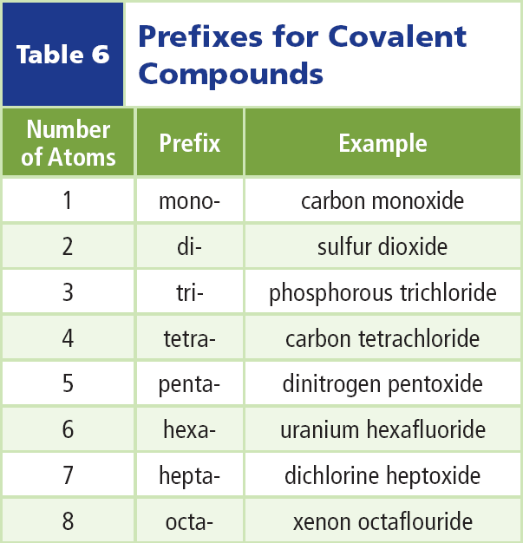
Using Prefixes
Scientists use Greek prefixes to indicate how many atoms of each element are in a binary covalent compound.
Notice that the last vowel of the prefix is dropped when the second element begins with a vowel as in pentoxide.

Slide 27
Using Prefixes
Often the prefix mono- is omitted, although it is used for emphasis in some cases.

Slide 28
Using Prefixes
These same prefixes are used when naming the hydrates previously discussed.
The main ionic compound is named the regular way, but the number of water molecules in the hydrate is indicated by the Greek prefix.

Slide 29
Section Check
Question 1
What does the oxidation number of an element tell you?
Answer
The oxidation number indicates how many electrons an atom has gained, lost, or shared in order to become stable.

Slide 30
Section Check
Question 2
A __________ is a compound composed of two elements.
Answer
A binary compound is composed of two elements. Potassium iodide is a binary ionic compound.

Slide 31
Section Check
Question 3
What is a hydrate?
Answer
A hydrate is a compound that has water chemically attached to its ions. Water is also written into its chemical formula.

