Slide 1
Gain or Loss of Electrons
Atoms lose or gain electrons to meet a standard—a stable energy level.
An atom that has lost or gained electrons is called an ion. An ion is a charged particle because it now has either more or fewer electrons than protons.

Slide 2
Gain or Loss of Electrons
The positive and negative charges are not balanced.
It is the electric forces between oppositely charged particles, such as ions, that hold compounds together.

Slide 3
Gain or Loss of Electrons
Some of the most common compounds are made by the loss and gain of just one electron.
Some examples are sodium chloride, commonly known as table salt; sodium fluoride, an anticavity ingredient in some toothpastes; and potassium iodide, an ingredient in iodized salt.

Slide 4
A Bond Forms
A neutral atom of potassium has one electron in its outer level. This is not a stable outer energy level.
When potassium forms a compound with iodine, potassium loses one electron from its fourth level, and the third level becomes a complete outer level.

Slide 5
A Bond Forms
The potassium atom has become an ion.
When a potassium atom loses an electron, the atom becomes positively charged because there is one electron less in the atom than there are protons in the nucleus
The 1+ charge is shown as a superscript written after the element’s symbol, K⁺ , to indicate its charge.

Slide 6
A Bond Forms
The iodine atom in this reaction undergoes a change.
An iodine atom has seven electrons in its outer energy level.
During the reaction with potassium, the iodide atom gains an electron, leaving its outer energy level with eight electrons.

Slide 7
A Bond Forms
This atom is no longer neutral because it gained an extra negative particle.
It now has a charge of 1− and is called an iodide ion, written as I⁻.

Slide 8
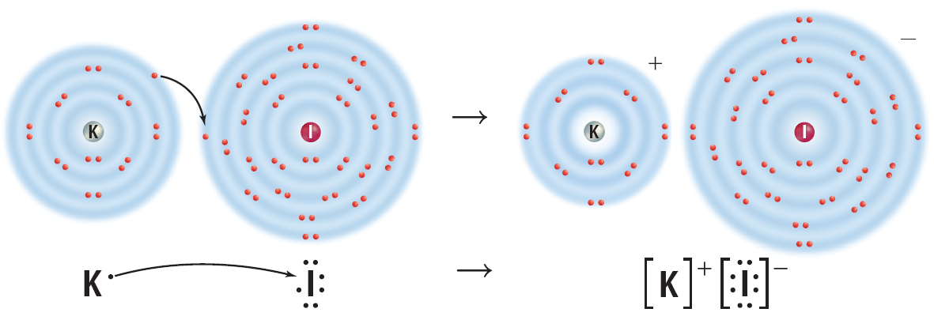
A Bond Forms
Notice that the resulting compound has a neutral charge because the positive and negative charges of the ions cancel each other.

Slide 9
The Ionic Bond
An ionic bond is the force of attraction between the opposite charges of the ions in an ionic compound.
In an ionic bond, a transfer of electrons takes place.
If an element loses electrons, one or more elements must gain an equal number of electrons to maintain the neutral charge of the compound.

Slide 10
The Ionic Bond
The formation of magnesium chloride, MgCl₂, is another example of ionic bonding.
When magnesium reacts with chlorine, a magnesium atom loses two electrons and becomes a positively charged ion, Mg²⁺.

Slide 11
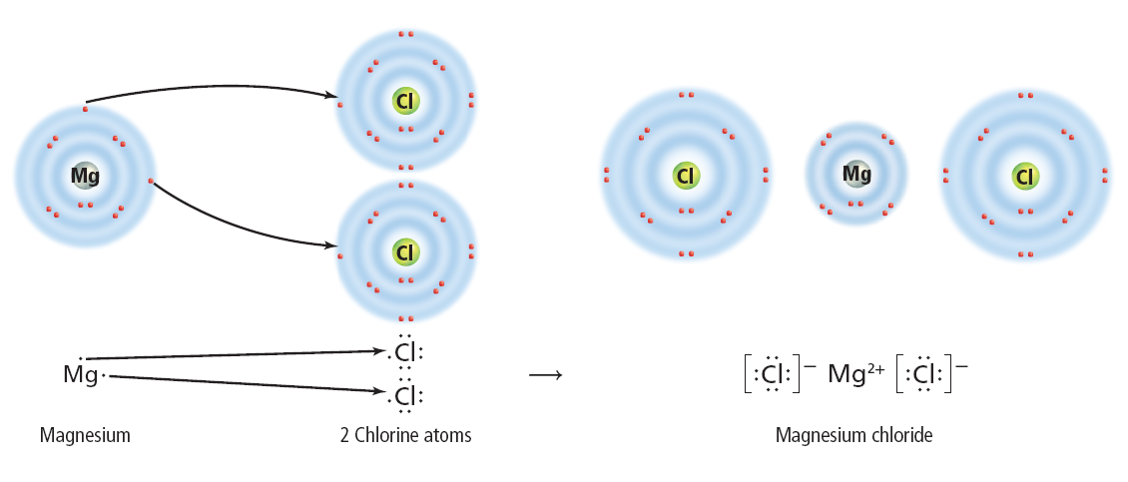
The Ionic Bond
At the same time, two chlorine atoms gain one electron each and become negatively charged chloride ions, Cl ⁻.

Slide 12
Zero Net Charge
The result of this bond is a neutral compound.
The compound as a whole is neutral because the sum of the charges on the ions is zero.

Slide 13
Zero Net Charge
When atoms form an ionic compound, their electrons are shifted to the other atoms, but the overall number of protons and electrons of the combined atoms remains equal and unchanged. Therefore, the compound is neutral.
Ionic bonds usually are formed by bonding between metals and nonmetals.

Slide 14
Sharing Electrons
Some atoms of nonmetals are unlikely to lose or gain electrons.
For example, the elements in Group 4 of the periodic table have four electrons in their outer levels.
They would have to either gain or lose four electrons in order to have a stable outer level.

Slide 15
Sharing Electrons
The loss of this many electrons takes a great deal of energy.
Therefore, these atoms become more chemically stable by sharing electrons, rather than by losing or gaining electrons.
Click image to view movie

Slide 16
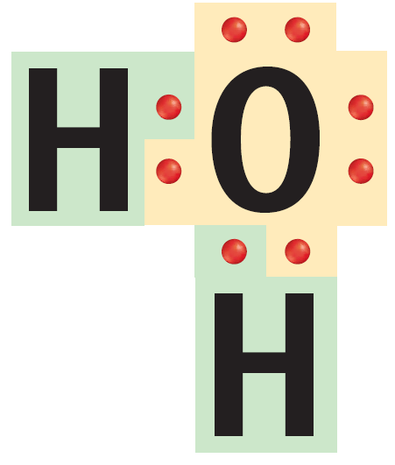
Sharing Electrons
The attraction that forms between atoms when they share electrons is known as a covalent bond.
A neutral particle that forms as a result of electron sharing is called a molecule.

Slide 17
Single Covalent Bonds
A single covalent bond is made up of two shared electrons.
A water molecule contains two single bonds. In each bond, a hydrogen atom contributes one electron to the bond and the oxygen atom contributes the other.
The result of this type of bonding is a stable outer energy level for each atom in the molecule.

Slide 18
Multiple Bonds
A covalent bond also can contain more than one pair of electrons.
An example of this is the bond in oxygen (O₂) or nitrogen (N₂).

Slide 19
Multiple Bonds
A nitrogen atom has five electrons in its outer energy level and needs to gain three electrons to become stable.
It does this by sharing its three electrons with another nitrogen atom.

Slide 20
Multiple Bonds
When each atom contributes three electrons to the bond, the bond contains six electrons, or three pairs of electrons.
Each pair of electrons represents a bond.
Therefore, three pairs of electrons represent three bonds, or a triple bond.

Slide 21
Unequal Sharing
Electrons are not always shared equally between atoms in a covalent bond.
These elements are close together in the upper right-hand corner of the periodic table. The strength of the attraction of each atom to its electrons is related to the size of the atom, the charge of the nucleus, and the total number of electrons the atom contains.

Slide 22
Unequal Sharing
Part of the strength of attraction has to do with how far away from the nucleus the electron being shared is.
The other part of the strength of attraction has to do with the size of the positive charge in the nucleus.

Slide 23
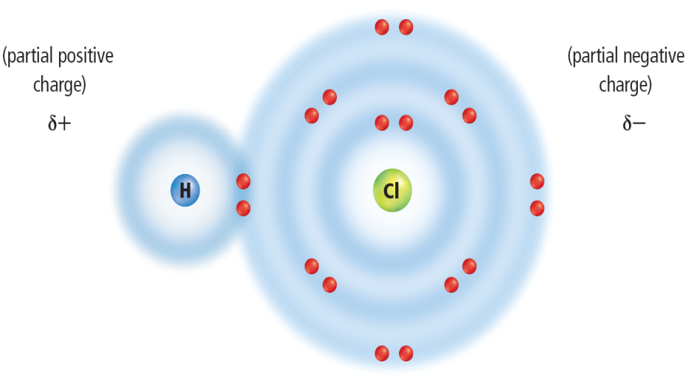
Unequal Sharing
One example of this unequal sharing is found in a molecule of hydrogen chloride, HCl.
Click image to view movie
Chlorine atoms have a stronger attraction for electrons than hydrogen atoms do.

Slide 24
Unequal Sharing
As a result, the electrons shared in hydrogen chloride will spend more time near the chlorine atom than near the hydrogen atom.

Slide 25
Tug-of-War
You might think of the bond as the rope in a tug-of-war and the shared electrons as the knot in the center of the rope.
Each atom in the molecule attracts the electrons that they share. However, sometimes the atoms aren’t the same size.

Slide 26
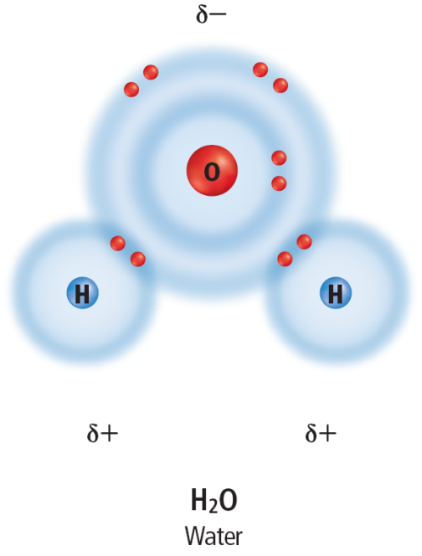
Polar or Nonpolar?
The charge is balanced but not equally distributed. This type of molecule is called polar bond.
A polar molecule is one that has a slightly positive end and a slightly negative end although the overall molecule is neutral. Water is an example of a polar molecule.

Slide 27
Polar or Nonpolar?
A nonpolar molecule is one in which electrons are shared equally in bonds.
Such a molecule does not have oppositely charged ends.
This is true of molecules made from two identical atoms or molecules that are symmetric, such as CCl₄.

Slide 28
Section Check
Question 1
When ionic bonds form, the resulting compounds are __________.
A. electrically neutral
B. electrically unstable
C. negatively charged
D. positively charged

Slide 29
Section Check
Answer
The answer is A. In an ionic bond, a transfer of electrons takes place and the overall neutral charge is maintained.

Slide 30
Section Check
Question 2
The attraction that forms between atoms when they share electrons is __________.
A. a binary compound
B. a covalent bond
C. an ionic bond
D. the oxidation number

Slide 31
Section Check
Answer
The answer is B. A single covalent bond is made up of two shared electrons.

Slide 32
Section Check
Question 3
In what type of molecule are electrons shared equally?
A. diatomic
B. nonpolar
C. polar
D. water

Slide 33
Section Check
Answer
The answer is B. In a nonpolar molecule, electrons are shared equally and the molecule does not have oppositely charged ends.

