Slide 1
Compounds
Some of the matter around you is in the form of uncombined elements such as copper, sulfur, and oxygen.
Like many other sets of elements, these three elements unite chemically to form a compound when the conditions are right.

Slide 2
Compounds
The green coating on the Statue of Liberty and some old pennies is a result of this chemical change.
The compound formed when elements combine often has properties that aren’t anything like those of the individual elements.
Sodium chloride, for example, is a compound made from the elements sodium and chlorine.

Slide 3
Formulas
A chemical formula tells what elements a compound contains and the exact number of the atoms of each element in a unit of that compound.
The compound that you are probably most familiar with is H₂O, more commonly known as water.

Slide 4
Formulas
This formula contains the symbols H for the element hydrogen and O for the element oxygen.
Notice the subscript number 2 written after the H for hydrogen.

Slide 5
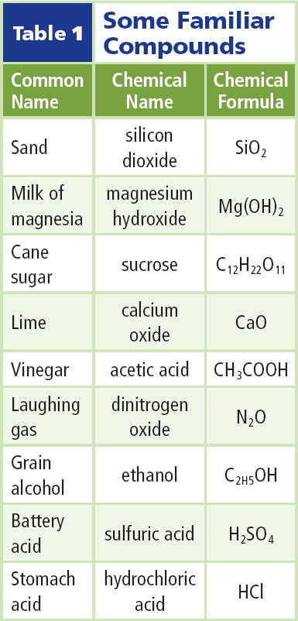
Formulas
A subscript written after a symbol tells how many atoms of that element are in a unit of the compound.

Slide 6
Formulas
If a symbol has no subscript, the unit contains only one atom of that element. A unit of H₂O contains two hydrogen atoms and one oxygen atom.

Slide 7
Atomic Stability
The electric forces between oppositely charged electrons and protons hold atoms and molecules together, and thus are the forces that cause compounds to form.
Atoms of noble gases are unusually stable.
Compounds of these atoms rarely form because they are almost always less stable than the original atoms.

Slide 8
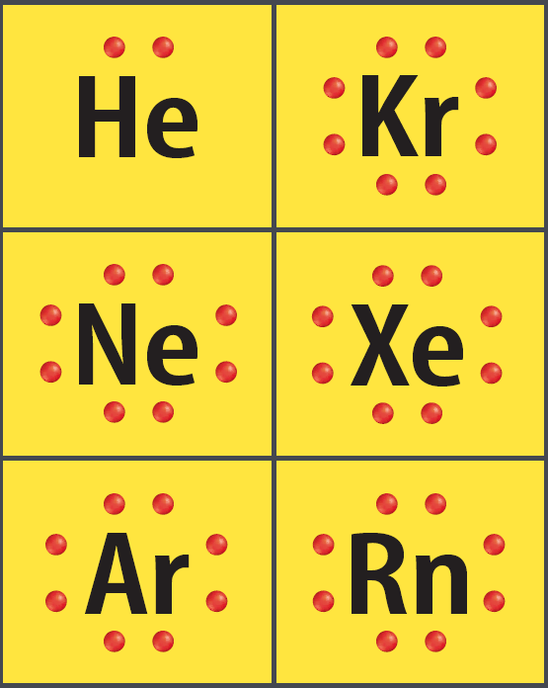
The Unique Noble Gases
To understand the stability of the noble gases, it is helpful to look at electron dot diagrams.
Electron dot diagrams show only the electrons in the outer energy level of an atom.

Slide 9
Chemical Stability
The noble gases are stable because they each have a complete outer energy level.
Notice that eight dots surround Kr, Ne, Xe, Ar, and Rn, and two dots surround He.

Slide 10
Energy Levels and Other Elements
Hydrogen contains one electron in its lone energy level.
A dot diagram for hydrogen has a single dot next to its symbol. This means that hydrogen’s outer energy level is not full.
It is more stable when it is part of a compound.

Slide 11
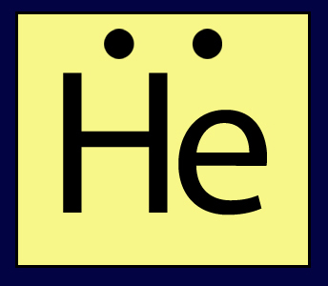
Energy Levels and Other Elements
In contrast, helium’s outer energy level contains two electrons.
Helium already has a full outer energy level by itself and is chemically stable.
Helium rarely forms compounds but, by itself, the element is a commonly used gas.

Slide 12
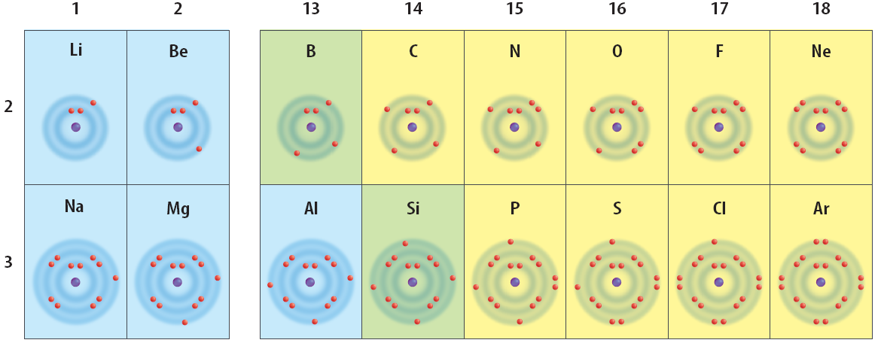
Energy Levels and Other Elements
When you look at the elements in groups 13 through 17, you see that each of them falls short of having a stable energy level.

Slide 13
Energy Levels and Other Elements
Each group contains too few electrons for a stable level of eight electrons.

Slide 14
Outer Levels —Getting Their Fill
How does hydrogen, or any other element, trying to become stable, gain or lose its outer electrons?
They do this by combining with other atoms that also have partially complete outer energy levels.
As a result, each achieves stability.

Slide 15
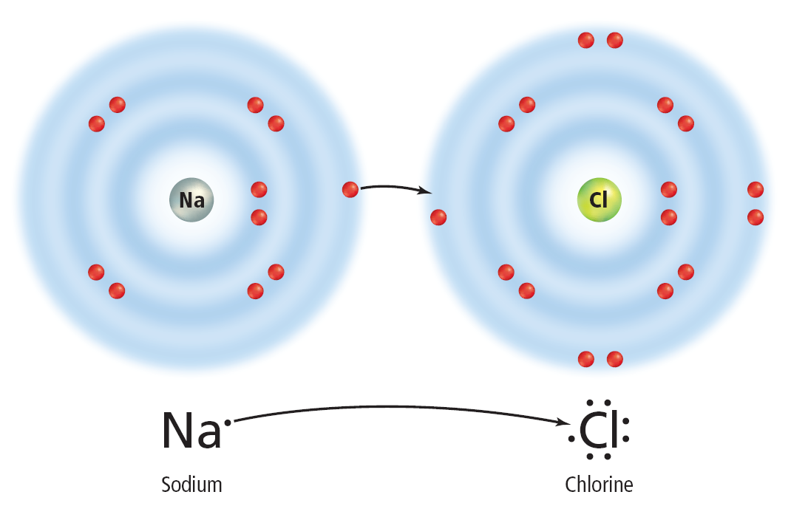
Outer Levels —Getting Their Fill
This illustration shows electron dot diagrams for sodium and chlorine.
When they combine, sodium loses one electron and chlorine gains one electron.

Slide 16
Outer Levels —Getting Their Fill
You can see from the electron dot diagram that chlorine now has a stable outer energy level.
Sodium had only one electron in its outer energy level, which it lost to combine with chlorine in sodium chloride.

Slide 17
Stability Is Reached
Look back to the next, outermost energy level of sodium.
This is now the new outer energy level, and it is stable with eight electrons.

Slide 18
Stability Is Reached
When atoms gain, lose, or share electrons, an attraction forms between the atoms, pulling them together to form a compound.
This attraction is called a chemical bond. A chemical bond is the force that holds atoms together in a compound.

Slide 19
Section Check
Question 1
What tells which elements a compound contains and how many atoms of each element are in one unit of a compound?

Slide 20
Section Check
Answer
A chemical formula is a form of chemical shorthand that tells what elements and how many atoms of each are in one unit of a compound.

Slide 21
Section Check
Question 2
The number of __________ in each group’s outer energy level increases across the periodic table.
A. electrons
B. neutrons
C. protons
D. protons and neutrons

Slide 22
Section Check
Answer
The answer is A. Protons and neutrons are located in the nucleus of the atom.

Slide 23
Section Check
Question 3
What is the force that holds atoms together in compounds?
Answer
The force that holds atoms together in compounds is a chemical bond.

