Slide 1
Organizing the Elements
Periodic means "repeated in a pattern."
In the late 1800s, Dmitri Mendeleev, a Russian chemist, searched for a way to organize the elements.
When he arranged all the elements known at that time in order of increasing atomic masses, he discovered a pattern.

Slide 2
Organizing the Elements
Because the pattern repeated, it was considered to be periodic. Today, this arrangement is called a periodic table of elements.
In the periodic table, the elements are arranged by increasing atomic number and by changes in physical and chemical properties.

Slide 3
Mendeleev's Predictions
Mendeleev had to leave blank spaces in his periodic table to keep the elements properly lined up according to their chemical properties.
He looked at the properties and atomic masses of the elements surrounding these blank spaces.

Slide 4
Mendeleev's Predictions
From this information, he was able to predict the properties and the mass numbers of new elements that had not yet been discovered.

Slide 5
Mendeleev's Predictions
This table shows Mendeleev's predicted properties for germanium, which he called ekasilicon. His predictions proved to be accurate.

Slide 6
Changes in the Periodic Table
On Mendeleev's table, the atomic mass gradually increased from left to right. If you look at the modern periodic table, you will see several examples, such as cobalt and nickel, where the mass decreases from left to right.

Slide 7
Changes in the Periodic Table
In 1913, the work of Henry G.J. Moseley, a young English scientist, led to the arrangement of elements based on their increasing atomic numbers instead of an arrangement based on atomic masses.
The current periodic table uses Moseley's arrangement of the elements.

Slide 8
The Atom and the Periodic Table
The vertical columns in the periodic table are called groups, or families, and are numbered 1 through 18.
Elements in each group have similar properties.

Slide 9
Electron Cloud Structure
In a neutral atom, the number of electrons is equal to the number of protons.
Therefore, a carbon atom, with an atomic number of six, has six protons and six electrons.

Slide 10
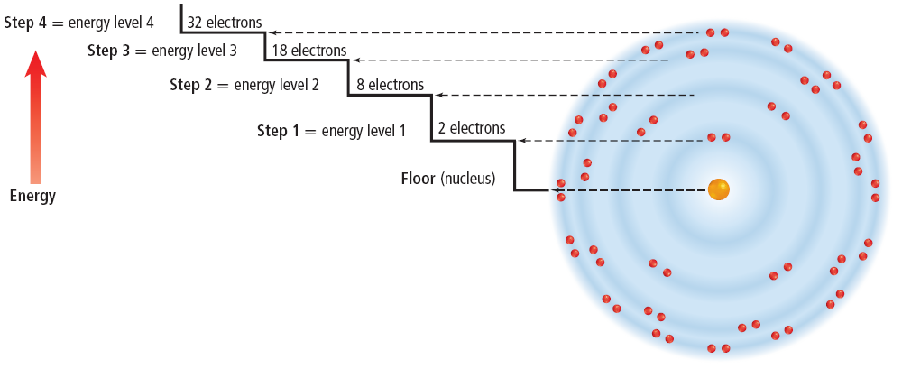
Electron Cloud Structure
Scientists have found that electrons within the electron cloud have different amounts of energy.

Slide 11
Energy Levels
Scientists model the energy differences of the electrons by placing the electrons in energy levels.

Slide 12
Energy Levels
Energy levels nearer the nucleus have lower energy than those levels that are farther away.
Electrons fill these energy levels from the inner levels (closer to the nucleus) to the outer levels (farther from the nucleus).

Slide 13
Energy Levels
Elements that are in the same group have the same number of electrons in their outer energy level.
It is the number of electrons in the outer energy level that determines the chemical properties of the element.

Slide 14
Energy Levels
The maximum number of electrons that can be contained in each of the first four levels is shown.

Slide 15
Energy Levels
For example, energy level one can contain a maximum of two electrons.
A complete and stable outer energy level will contain eight electrons.

Slide 16
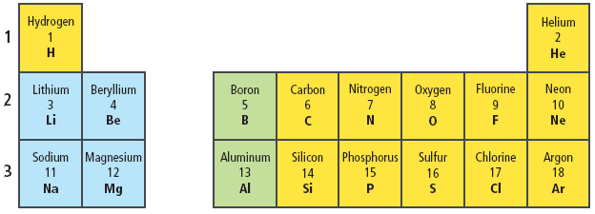
Rows on the Periodic Table
Remember that the atomic number found on the periodic table is equal to the number of electrons in an atom.

Slide 17
Rows on the Periodic Table
The first row has hydrogen with one electron and helium with two electrons both in energy level one.
Energy level one can hold only two electrons. Therefore, helium has a full or complete outer energy level.

Slide 18
Rows on the Periodic Table
The second row begins with lithium, which has three electrons—two in energy level one and one in energy level two.
Lithium is followed by beryllium with two outer electrons, boron with three, and so on until you reach neon with eight outer electrons.

Slide 19
Rows on the Periodic Table
Do you notice how the row in the periodic table ends when an outer level is filled?
In the third row of elements, the electrons begin filling energy level three.
The row ends with argon, which has a full outer energy level of eight electrons.

Slide 20
Electron Dot Diagrams
Elements that are in the same group have the same number of electrons in their outer energy level.
These outer electrons are so important in determining the chemical properties of an element that a special way to represent them has been developed.

Slide 21
Electron Dot Diagrams
An electron dot diagram uses the symbol of the element and dots to represent the electrons in the outer energy level.
Electron dot diagrams are used also to show how the electrons in the outer energy level are bonded when elements combine to form compounds.

Slide 22
Same Group—Similar Properties
The elements in Group 17, the halogens, have electron dot diagrams similar to chlorine.
All halogens have seven electrons in their outer energy levels.

Slide 23
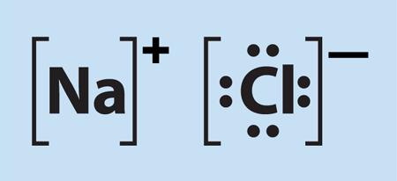
Same Group—Similar Properties
A common property of the halogens is the ability to form compounds readily with elements in Group 1.
The Group 1 element, sodium, reacts easily with the Group 17 element, chlorine.
The result is the compound sodium chloride, or NaCl—ordinary table salt.

Slide 24
Same Group—Similar Properties
Not all elements will combine readily with other elements.
The elements in Group 18 have complete outer energy levels.
This special configuration makes Group 18 elements relatively unreactive.

Slide 25
Regions on the Periodic Table
The periodic table has several regions with specific names.
The horizontal rows of elements on the periodic table are called periods.
The elements increase by one proton and one electron as you go from left to right in a period.

Slide 26
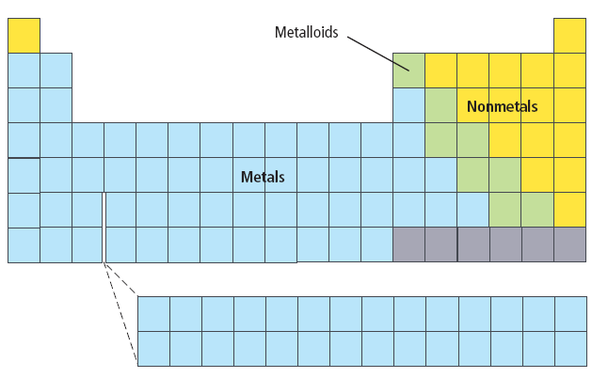
Regions on the Periodic Table
All of the elements in the blue squares are metals.

Slide 27
Regions on the Periodic Table
Those elements on the right side of the periodic table, in yellow, are classified as nonmetals.

Slide 28
Regions on the Periodic Table
The elements in green are metalloids or semimetals.

Slide 29
New Elements
In 1994, scientists at the Heavy-Ion Research Laboratory in Darmstadt, Germany, discovered element 111.
Element 112 was discovered at the same laboratory.
Both of these elements are produced in the laboratory by joining smaller atoms into a single atom.

Slide 30
Elements in the Universe
Using the technology that is available today, scientists are finding the same elements throughout the universe.
Many scientists believe that hydrogen and helium are the building blocks of other elements.

Slide 31
Elements in the Universe
Exploding stars, or supernovas, give scientists evidence to support this theory.
Many scientists believe that supernovas have spread the elements that are found throughout the universe.

Slide 32
Section Check
Question 1
How are the elements arranged in the periodic table?

Slide 33
Section Check
Answer
The elements are arranged by increasing atomic number and by changes in physical and chemical properties.

Slide 34
Section Check
Question 2
What do the elements in a vertical column of the periodic table have in common?

Slide 35
Section Check
Answer
The vertical columns in the periodic table are called groups; elements in the same group have similar properties, such as electrical conductivity.

Slide 36
Section Check
Question 3
What do the dots in this electron dot diagram represent?

Slide 37
Section Check
Answer
The dots represent the electrons in the outer energy level.

