Slide 1
Atomic Mass

Slide 2
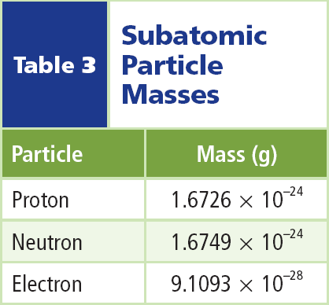
Atomic Mass
The nucleus contains most of the mass of the atom because protons and neutrons are far more massive than electrons.
The mass of a proton is about the same as that of a neutron.

Slide 3
Atomic Mass
The mass of each is approximately 1,800 times greater than the mass of the electron.

Slide 4
Atomic Mass
The unit of measurement used for atomic particles is the atomic mass unit (amu).
The mass of a proton or a neutron is almost equal to 1 amu.
The atomic mass unit is defined as one-twelfth the mass of a carbon atom containing six protons and six neutrons.

Slide 5
Atomic Number
The number of protons tells you what type of atom you have and vice versa. For example, every carbon atom has six protons. Also, all atoms with six protons are carbon atoms.
The number of protons in an atom is equal to a number called the atomic number.

Slide 6
Mass Number
The mass number of an atom is the sum of the number of protons and the number of neutrons in the nucleus of an atom.

Slide 7
Mass Number
If you know the mass number and the atomic number of an atom, you can calculate the number of neutrons.
number of neutrons = mass number – atomic number

Slide 8
Isotopes
Not all the atoms of an element have the same number of neutrons.
Atoms of the same element that have different numbers of neutrons are called isotopes.

Slide 9
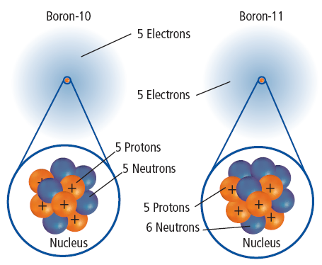
Isotopes
Models of two isotopes of boron are shown. Because the numbers of neutrons in the isotopes are different, the mass numbers are also different.
You use the name of the element followed by the mass number of the isotope to identify each isotope: boron-10 and boron-11.

Slide 10
Identifying Isotopes
The average atomic mass of an element is the weighted-average mass of the mixture of its isotopes.
For example, four out of five atoms of boron are boron-11, and one out of five is boron-10.
To find the weighted-average or the average atomic mass of boron, you would solve the following equation:

Slide 11
Section Check
Question 1
How is the atomic number of an element determined?
Answer
The atomic number of an element is equal to the number of protons in an atom of that element.

Slide 12
Section Check
Question 2
The element helium has a mass number of 4 and atomic number of 2. How many neutrons are in the nucleus of a helium atom?

Slide 13
Section Check
Answer
Recall that the atomic number is equal to the number of protons in the nucleus. Since the mass number is 4 and the atomic number is 2, there must be 2 neutrons in the nucleus of a helium atom.

Slide 14
Section Check
Question 3
How much of the mass of an atom is contained in an electron?
Answer
The electron’s mass is so small that it is considered negligible when finding the mass of an atom.

