Slide 1
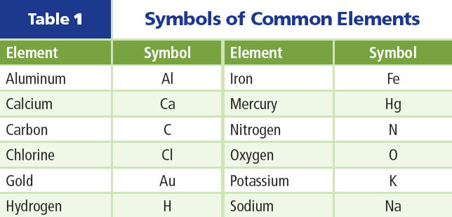
Scientific Shorthand
Scientists have developed their own shorthand for dealing with long, complicated names.
Chemical symbols consist of one capital letter or a capital letter plus one or two smaller letters.

Slide 2
Scientific Shorthand
For some elements, the symbol is the first letter of the element's name.
For other elements, the symbol is the first letter of the name plus another letter from its name.
Because scientists worldwide use this system, everyone understands what the symbols mean.

Slide 3
Subatomic Particles
An element is matter that is composed of one type of atom, which is the smallest piece of matter that still retains the property of the element.
Atoms are composed of particles called protons, neutrons, and electrons.
Click image to view movie

Slide 4
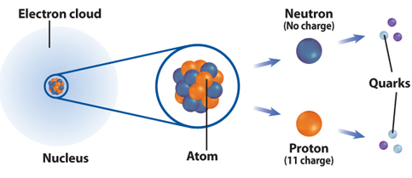
Atomic Components
Protons and neutrons are found in a small positively charged center of the atom called the nucleus that is surrounded by a cloud containing electrons.
Protons are particles with an electrical charge of 1+.

Slide 5
Atomic Components
Electrons are particles with an electrical charge of 1–.
Neutrons are neutral particles that do not have an electrical charge.

Slide 6
Quarks—Even Smaller Particles
Protons and neutrons are made up of smaller particles called quarks.
So far, scientists have confirmed the existence of six uniquely different quarks.

Slide 7
Quarks—Even Smaller Particles
Scientists theorize that an arrangement of three quarks held together with the strong nuclear force produces a proton.
Another arrangement of three quarks produces a neutron

Slide 8
The Search for Quarks
To study quarks, scientists accelerate charge particles to tremendous speeds and then force them to collide with—or smash into—protons. This collision causes the proton to break apart.
The particles that result from the collision can be detected by various collection devises.

Slide 9
The Sixth Quark
Scientists found five quarks and hypothesized that a sixth quark existed. However, it took a team of nearly 450 scientists from around the world several years to find the sixth quark.
The tracks of the sixth quark were hard to detect because only about one billionth of a percent of the proton collisions performed shows a presence of a sixth quark.

Slide 10
Models—Tools for Scientists
Scientists and engineers use models to represent things that are difficult to visualize—or picture in your mind.
Scaled-down models allow you to see either something too large to see all at once, or something that has not been built yet.
Scaled-up models are often used to visualize things that are too small to see.

Slide 11
Models—Tools for Scientists
To study the atom, scientists have developed scaled-up models that they can use to visualize how the atom is constructed.
For the model to be useful, it must support all of the information that is known about matter and the behavior of atoms.

Slide 12
The Atomic Model
In the 1800s, John Dalton, an English scientist, was able to offer proof that atoms exist.
Another famous Greek philosopher, Aristotle, disputed Democritus's theory and proposed that matter was uniform throughout and was not composed of smaller particles.

Slide 13
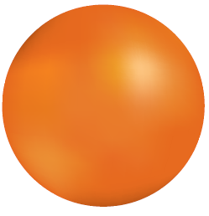
The Atomic Model
In the 1800s, John Dalton, an English scientist, was able to offer proof that atoms exist.
Dalton's model of the atom, a solid sphere was an early model of the atom.
The model has changed somewhat over time.

Slide 14
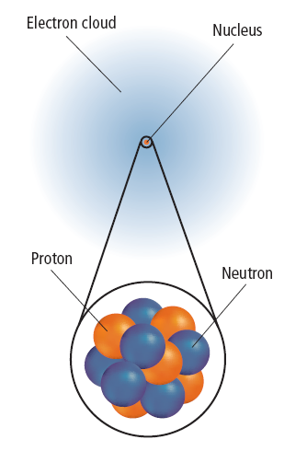
The Electron Cloud Model
By 1926, scientists had developed the electron cloud model of the atom that is in use today.
An electron cloud is the area around the nucleus of an atom where its electrons are most likely found.

Slide 15
The Electron Cloud Model
The electron cloud is 100,000 times larger than the diameter of the nucleus.
In contrast, each electron in the cloud is much smaller than a single proton.
Because an electron's mass is small and the electron is moving so quickly around the nucleus, it is impossible to describe its exact location in an atom.

Slide 16
Section Check
Question 1
Which is the smallest piece of matter that still retains the property of the element?
A. atom
B. quark
C. neutron
D. proton

Slide 17
Section Check
Answer
The answer is A. An atom is the smallest piece of matter that still retains the property of the element.

Slide 18
Section Check
Question 2
What particles are found in the nucleus of an atom?
A. protons and electrons
B. protons and neutrons
C. neutrons and electrons
D. quarks and electrons

Slide 19
Section Check
Answer
The answer is B. Electrons are located in an electron cloud surrounding the nucleus of the atom.

Slide 20
Section Check
Question 3
What is the name of the small particles that make up protons and neutrons?
Answer
Protons and neutrons are made of smaller particles called quarks.

