Slide 1
Physical Properties
Any characteristic of a material that you can observe without changing the identity of the substances that make up the material is a physical property.
Examples of physical properties are color, shape, size, density, melting point, and boiling point.

Slide 2
Appearance
How would you describe a basketball? You could begin by describing its shape, color, and state of matter.
You can measure some physical properties, too. For instance, you could measure the diameter of the ball.

Slide 3
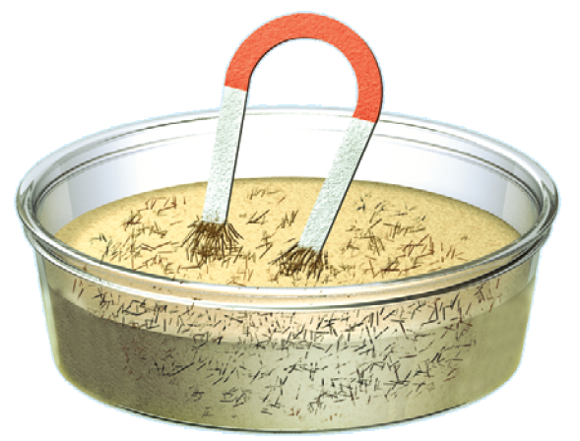
Behavior
Some physical properties describe the behavior of a material or a substance.
Attraction to a magnet is a physical property of the substance iron.
Every substance has a specific combination of physical properties that make it useful for certain tasks.

Slide 4
Using Physical Properties to Separate Mixtures
The best way to separate substances depends on their physical properties.
Size is one physical property often used to separate substances.

Slide 5
Using Physical Properties to Separate Mixtures
Look at the mixture of iron filings and sand shown.
You probably won’t be able to sift out the iron filings because they are similar in size to the sand particles. What you can do is pass a magnet through the mixture.

Slide 6
Using Physical Properties to Separate Mixtures
The magnet attracts only the iron filings and pulls them from the sand. This is an example of how a physical property, such as magnetic attraction, can be used to separate substances in a mixture.

Slide 7
The Identity Remains the Same
A change in size, shape, or state of matter is called a physical change.
These changes might involve energy changes, but the kind of substance—the identity of the element or compound—does not change.

Slide 8
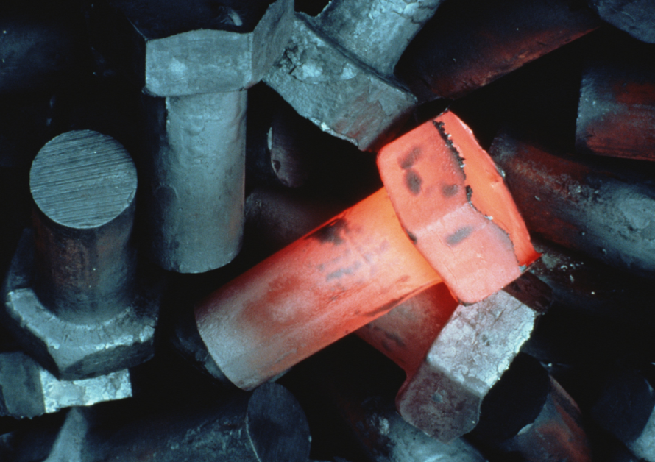
The Identity Remains the Same
Iron is a substance that can change states if it absorbs or releases enough energy—at high temperatures, it melts.
Color changes can accompany a physical change, too.
PhotoLink/Getty Images

Slide 9
The Identity Remains the Same
For example, when iron is heated it first glows red. Then, if it is heated to a higher temperature, it turns white.
PhotoLink/Getty Images

Slide 10
Using Physical Change to Separate
Many such areas that lie close to the sea obtain drinking water by using physical properties of water to separate it from the salt.
One of these methods, which uses the property of boiling point, is a type of distillation.

Slide 11
Distillation
The process for separating substances in a mixture by evaporating a liquid and recondensing its vapor is distillation.
It usually is done in the laboratory using an apparatus similar to that shown.

Slide 12
Distillation
Two liquids having different boiling points can be separated in a similar way.
The mixture is heated slowly until it begins to boil.
Vapors of the liquid with the lowest boiling point form first and are condensed and collected. Then, the temperature is increased until the second liquid boils, condenses, and is collected.

Slide 13
Chemical Properties and Changes
The tendency of a substance to burn, or its flammability, is an example of a chemical property because burning produces new substances during a chemical change.
A chemical property is a characteristic of a substance that indicates whether it can undergo a certain chemical change.

Slide 14
Detecting Chemical Change
If you leave a pan of chili cooking unattended on the stove for too long, your nose soon tells you that something is wrong.
This burnt odor is a clue telling you that a new substance has formed.

Slide 15
The Identity Changes
A change of one substance to another is a chemical change.
The foaming of an antacid tablet in a glass of water and the smell in the air after a thunderstorm are other signs of new substances being produced.
Click image to view movie

Slide 16
The Identity Changes
Clues such as heat, cooling, or the formation of bubbles or solids in a liquid are helpful indicators that a reaction is taking place.
However, the only sure proof is that a new substance is produced.
The only clue that iron has changed into a new substance is the presence of rust.
Burning and rusting are chemical changes because new substances form.

Slide 17
Using Chemical Change to Separate
One case where you might separate substances using a chemical change is in cleaning tarnished silver.
Tarnish is a chemical reaction between silver metal and sulfur compounds in the air which results in silver sulfide.
It can be changed back into silver using a chemical reaction.

Slide 18
Using Chemical Change to Separate
You don’t usually separate substances using chemical changes in the home.
In industry and chemical laboratories, however, this kind of separation is common. For example, many metals are separated from their ores and then purified using chemical changes.

Slide 19
Weathering—Chemical or Physical Change?
The forces of nature continuously shape Earth’s surface. Rocks split, deep canyons are carved out, sand dunes shift, and curious limestone formations decorate caves.
Do you think these changes, often referred to as weathering, are physical or chemical? The answer is both.

Slide 20
Physical
Large rocks can split when water seeps into small cracks, freezes, and expands.
However, the smaller pieces of newly exposed rock still have the same properties as the original sample.
This is a physical change.

Slide 21
Chemical
Solid calcium carbonate, a compound found in limestone, does not dissolve easily in water.
However, when the water is even slightly acidic, as it is when it contains some dissolved carbon dioxide, calcium carbonate reacts.
It changes into a new substance, calcium hydrogen carbonate, which does dissolve in water.

Slide 22
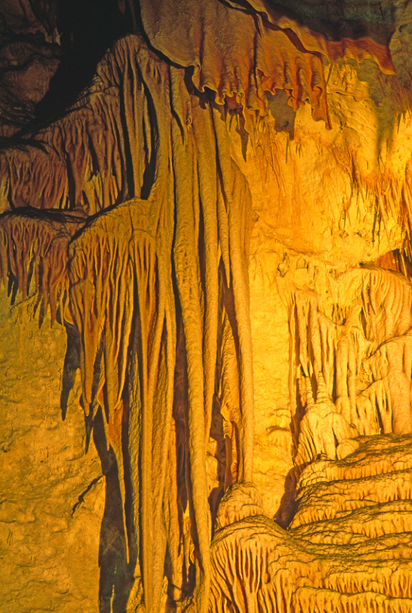
Chemical
A similar chemical change produces caves and the icicle shaped rock formations that often are found in them.
Doug Sherman/Geofile

Slide 23
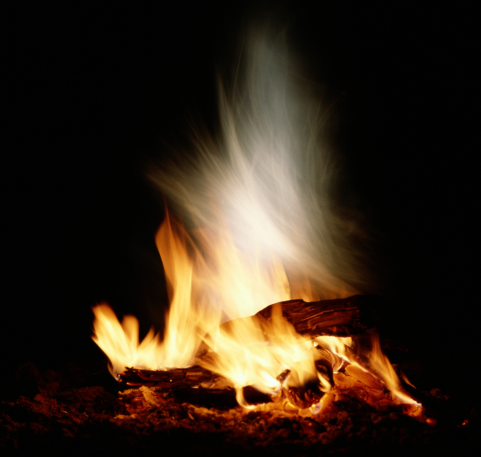
The Conservation of Mass
Suppose you burn a large log until nothing is left but a small pile of ashes.
At first, you might think that matter was lost during this change because the pile of ashes looks much smaller than the log did.
Don Farrall/Getty Images

Slide 24
The Conservation of Mass
In fact, the mass of the ashes is less than that of the log.
Don Farrall/Getty Images

Slide 25
The Conservation of Mass
However, suppose that you could collect all the oxygen in the air that was combined with the log during the burning and all the smoke and gases that escaped from the burning log and measure their masses, too.
Then you would find that no mass was lost after all.

Slide 26
The Conservation of Mass
Not only is no mass lost during burning, mass is not gained or lost during any chemical change.
According to the law of conservation of mass, the mass of all substances that are present before a chemical change equals the mass of all the substances that remain after the change.

Slide 27
Section Check
Question 1
Which of the following is a chemical property?
A. boiling point
B. density
C. flammability
D. melting point

Slide 28
Section Check
Answer
The answer is C. Flammability indicates whether a substance will undergo the chemical change of burning.

Slide 29
Section Check
Question 2
A characteristic of a material that can be observed without changing the identity of the substances that make up the material is a _______.

Slide 30
Section Check
Answer
The answer is physical property. Examples of physical properties include color, shape, and density.

Slide 31
Section Check
Question 3
What is the law of conservation of mass?

Slide 32
Section Check
Answer
According to the law of conservation of mass, the mass of all substances that are present before a chemical change equals the mass of all substances that remain after the change.

