Slide 1
Reviewing Main Ideas
Acids and Bases
An acid is a substance that produces hydrogen ions, H⁺, in solution. A base produces hydroxide ions, OH‾, in solution.
Some foods can be classified as acidic or basic. Properties of acids and bases are due, in part, to the presence of the H⁺ and OH‾ ions.

Slide 2
Reviewing Main Ideas
Acids and Bases
Common acids include hydrochloric acid, sulfuric acid, nitric acid, and phosphoric acid. Common bases include sodium hydroxide, calcium hydroxide, and ammonia.
Acidic solutions form when certain polar compounds ionize as they dissolve in water. Except for ammonia, basic solutions form when certain ionic compounds dissociate upon dissolving in water.

Slide 3
Reviewing Main Ideas
Strength of Acids and Bases
Then strength of an acid or base is determined by how completely it forms ions when it is in solution.
Strength and concentration are not the same thing. Concentration involves the relative amounts of solvent and solute in a solution, whereas strength is related to the extent to which a substance ionizes or dissociates.

Slide 4
Reviewing Main Ideas
Strength of Acids and Bases
pH measures the concentration of hydronium ions in water solution.
For acidic solutions of equal concentration, the stronger the acid is, the lower its pH is. For basic solutions of equal concentration, the stronger the base is, the higher its pH is.

Slide 5
Reviewing Main Ideas
Salts
In a neutralization reaction, the H₃O+ ions from an acid react with the OH‾ ions from a base to produce water molecules. The products of a neutralization reaction are a salt and water.
Salts form when negative ions from an acid combine with positive ions from a base.

Slide 6
Reviewing Main Ideas
Salts
Soaps and detergents are salts. Unlike soaps, detergents do not react with compounds in hard water to form soap scum.

Slide 7
Chapter Review
Question 1
What are some common properties of acids?
Answer
Acids commonly taste sour, are corrosive, and react with metals and indicators.

Slide 8
Chapter Review
Question 2
What are some common properties of bases?
Answer
In their pure state, many bases are crystalline solids. In solution, they feel slippery and react with indicators.

Slide 9
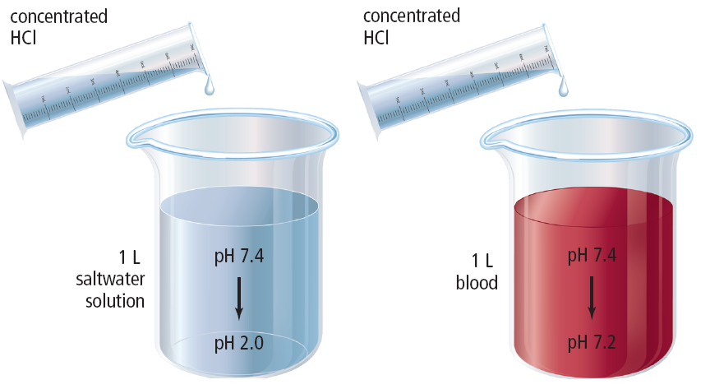
Chapter Review
Question 3
What is a buffer?

Slide 10
Chapter Review
Answer
Buffers are solutions that react with additional acids or bases and minimize their effects on pH.

Slide 11
Chapter Review
Question 4
What compounds are formed by the reaction of an acid and a base?
Answer
The reaction of acids and bases produces salts and water.

Slide 12
Chapter Review
Question 5
What is the purpose of titration?
Answer
A titration is the process by which a solution of known concentration is used to determine the concentration of another solution.

Slide 13
Standardized Test Practice
Question 1
Which of these is a hydronium ion?
A. H₃O⁺
B. OH–
C. COOH
D. HO₃

Slide 14
Standardized Test Practice
Answer
The answer is A. Hydronium ions result from the interaction of hydrogen ions and water molecules.

Slide 15
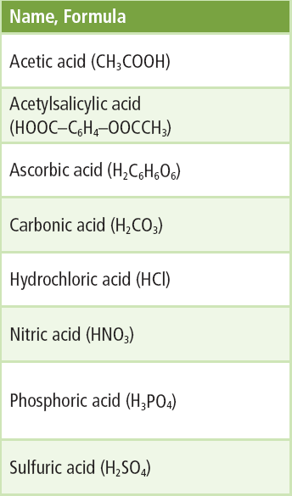
Standardized Test Practice
Question 2
Which acid listed is also known as vitamin C?
A. acetic acid
B. ascorbic acid
C. carbonic acid
D. nitric acid

Slide 16
Standardized Test Practice
Answer
The answer is B. Ascorbic acid is vitamin C; acetic acid is known as vinegar.

Slide 17
Standardized Test Practice
Question 3
Which of the following equations represents the ionization of a strong acid?
A. HCl + H₂O → H₃O⁺ + Cl–
B. CH₃COOH + H₂O ↔ H₃O⁺ + CH₃COO–
C. NH₃ + H₂O ↔ NH₄ + OH–
D. HCl + NaHCO₃ → NaCl + CO₂ + H₂O

Slide 18
Standardized Test Practice
Answer
The answer is A.

Slide 19
Standardized Test Practice
Question 4
What type of reaction is represented by the equation
A. elimination
B. double displacement
C. neutralization
D. titration

Slide 20
Standardized Test Practice
Answer
The answer is C. An acid and a base react to form a salt and water, and in this case, carbon dioxide gas.

Slide 21
Standardized Test Practice
Question 5
Yogurt, butter milk, citrus fruits, and your stomach all contain _____.
A. bases
B. salts
C. soaps
D. acids

Slide 22
Standardized Test Practice
Answer
The answer is D. Citric acid is found in fruit, lactic acid is found in butter milk and yogurt, and hydrochloric acid digests food in your stomach.

