Slide 1
Neutralization
Neutralization is a chemical reaction between an acid and a base that takes place in a water solution.
For example, when HCI is neutralized by NaHCO₃, hydronium ions from the acid combine with hydroxide ions from the base to produce sodium chloride, carbon dioxide, and neutral water.

Slide 2
Neutralization
A salt is a compound formed when the negative ions from an acid combine with the positive ions from a base.

Slide 3
Acid-Base Reactions
The following general equation represents acid-base reactions in water.
Another neutralization reaction occurs between HCI, an acid, and Ca(OH)₂, a base producing water and the salt CaCl₂.

Slide 4
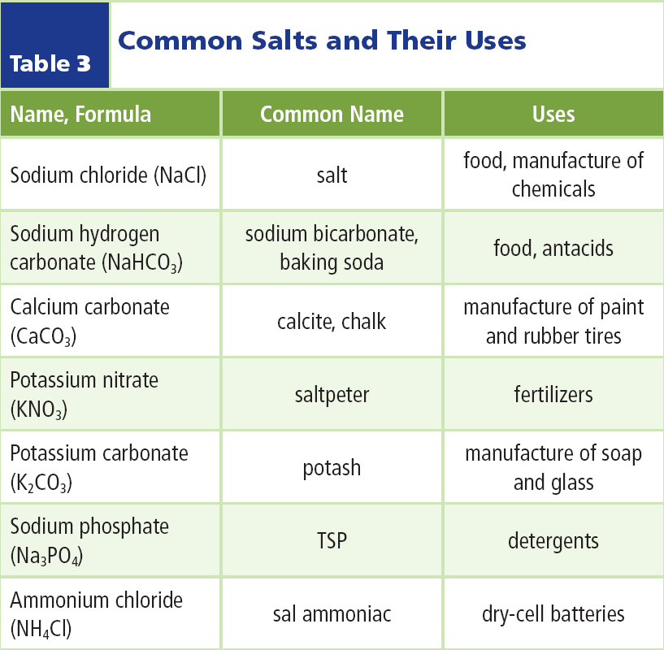
Salts
Salt is essential for many animals large and small.
You need salt too, especially because you lose salt in perspiration.

Slide 5
Salts
Most salts are composed of a positive metal ion and an ion with a negative charge, such as Cl⁻ or CO₃²⁻.
Ammonium salts contain the ammonium ion, NH₄⁺, rather than a metal.

Slide 6
Titration
Sometimes you need to know the concentration of an acidic or basic solution; for example, to determine the purity of a commercial product.
This can be done using a process called titration (ti TRAY shun), in which a solution of known concentration is used to determine the concentration of another solution.

Slide 7
Titration
Titration involves a solution of known concentration, called the standard solution.
This is added slowly and carefully to a solution of unknown concentration to which an acid/base indicator has been added.

Slide 8
Titration
If the solution of unknown concentration is a base, a standard acid solution is used.
If the unknown is an acid, a standard base solution is used.
Click box to play movie

Slide 9
The Endpoint Has a Color Change
To find the concentration of an acid solution, first, you would add a few drops of an indicator, such as phenolphthalein (fee nul THAY leen), to a carefully measured amount of the solution of unknown concentration.
Then, you would slowly and carefully add a base solution of known concentration to this acid-and-indicator mixture.

Slide 10
The Endpoint Has a Color Change
Toward the end of the titration you must add base drop by drop until one last drop of the base turns the solution pink and the color persists.
The point at which the color persists is known as the end point, the point at which the acid is completely neutralized by the base.

Slide 11
The Endpoint Has a Color Change
Many natural substances are acid-base indicators.
The indicator litmus comes from a lichen⎯a combination of a fungus and an algae or cyanobacterium.
Flowers that are indicators include hydrangeas, which produce blue blossoms when the pH of the soil is acidic and pink blossoms when the soil is basic.

Slide 12
Soaps and Detergents
The next time you are in a supermarket, go to the aisle with soaps and detergents. You’ll see all kinds of products⎯solid soaps, liquid soaps, and detergents for washing clothes and dishes.

Slide 13
Soaps and Detergents
Do they differ from one another? Yes, they do differ slightly in how they are made and in the ingredients included for color and aroma.
Still, all these products are classified into two types⎯soaps and detergents.

Slide 14
Soaps
Soaps are salts.
They have a nonpolar organic chain of carbon atoms on one end and either a sodium or potassium salt of a carboxylic acid (kar bahk SIHL ihk), –COOH, group at the other end.

Slide 15
Soaps
To make an effective soap, the acid must contain 12 to 18 carbon atoms.
If it contains fewer than 12 atoms, it will not be able to mix well with and clean oily dirt.

Slide 16
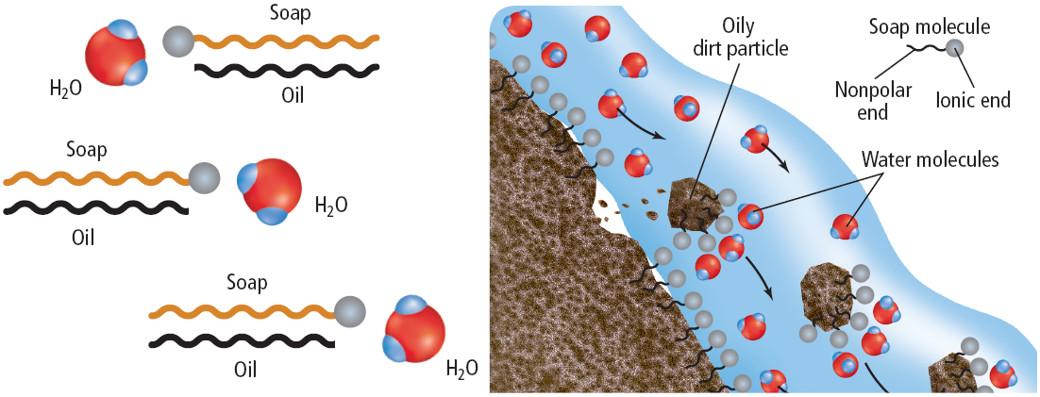
Soaps
The long hydrocarbon part of a soap molecule mixes well with oily dirt while the ionic end attracts water molecules.
Dirt now linked with the soap rinses away as water flows over it.

Slide 17
Commercial Soaps
A simple soap can be made by reacting a long-chain fatty acid with sodium or potassium hydroxide.
One problem with all soaps, however, is that the sodium and potassium ions can be replaced by ions of calcium, magnesium, and iron found in some water known as hard water.
Click box to play movie

Slide 18
Commercial Soaps
When this happens, the salts formed are insoluble.
They precipitate out of solution in the form of soap scum.

Slide 19
Detergents
Detergents are synthetic products that are made from petroleum molecules, instead of from natural fatty acids like their soap counterparts.
Similar to soaps, detergents have long hydrocarbon chains, but instead of a carboxylic acid group (–COOH) at the end, they may contain instead a sulfonic acid group.

Slide 20
Detergents
Some detergents contained phosphates, the use of which has been restricted or banned in many states, and these are no longer produced because they cause water pollution.
Certain sulfonic acid detergents also present problems in the form of excess foaming in water treatment plants and streams.

Slide 21
Section Check
Question 1
Neutralization takes place in a(n) _________ solution.
A. acid
B. base
C. gaseous
D. water

Slide 22
Section Check
Answer
The answer is D. Neutralization is a chemical reaction between an acid and a base and takes place is a water solution.

Slide 23
Section Check
Question 2
What type of compound forms when negative ions from an acid combine with positive ions from a base?
Answer
A salt is a compound that forms when negative ions from an acid combine with positive ions from a base.

Slide 24
Section Check
Question 3
What is the general equation representing acid-base reactions in water?
Answer
The general equation is acid + base → salt + water. A specific example is:

