Slide 1
Strong and Weak Acids and Bases
The strength of an acid or base depends on how many acid or base particles form into ions in water.
When a strong acid dissolves in water, nearly all the acid molecules form into ions.
When a weak acid dissolves in water, only a small fraction of the molecules dissolve in water.

Slide 2
Strong and Weak Acids and Bases
Ions in solution can conduct an electric current.
The ability of a solution to conduct a current can be demonstrated using a lightbulb connected to a battery with leads placed in the solution.

Slide 3
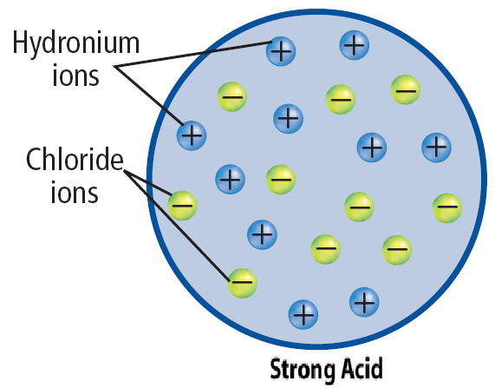
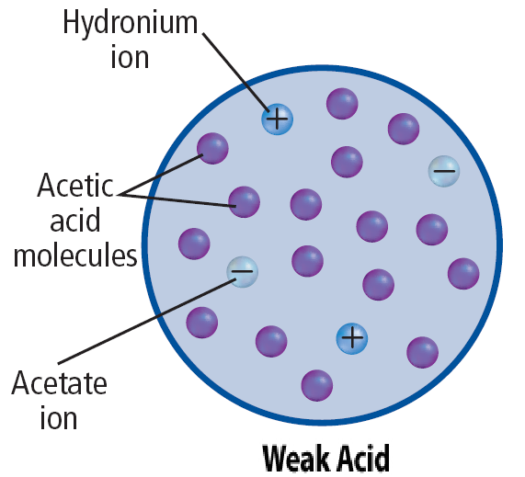
Strong and Weak Acids and Bases
The strong acid solution conducts more current and the lightbulb burns brightly.
The weak acid solution does not conduct as much current as a strong acid solution and the bulb burns less brightly.

Slide 4
Acid Strength
Equations describing dissociation can be written in two ways.
In strong acids, such as HCl, nearly all the acid ionizes.
This is shown by writing the equation using a single arrow pointing toward the ions that are formed.

Slide 5
Acid Strength
Equations describing the ionization of weak acids, such as acetic acid, are written using double arrows pointing in opposite directions.
This means that only some of the CH₃COOH ionizes and the reaction does not go to completion.

Slide 6
Base Strength
A strong base dissociates completely in solution.
The following equation shows the dissociation of sodium hydroxide, a strong base.

Slide 7
Base Strength
This dissociation of ammonia, which is a weak base, is shown using double arrows to indicate that not all the ammonia ionizes.
A weak base is one that does not dissociate completely.

Slide 8
Strength and Concentration
The terms strong and weak are used to classify acids and bases.
The terms refer to the ease with which an acid ionizes or base dissociates in solution.
Strong acids and bases ionize or dissociate completely; weak acids and bases ionize or dissociate only partially.

Slide 9
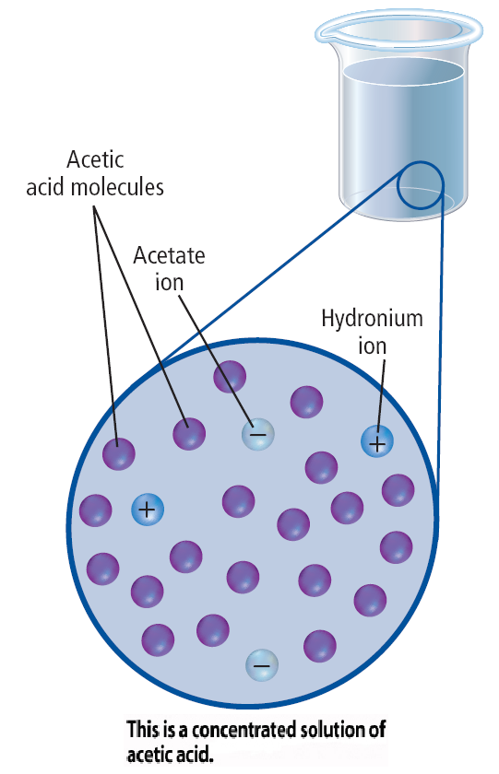
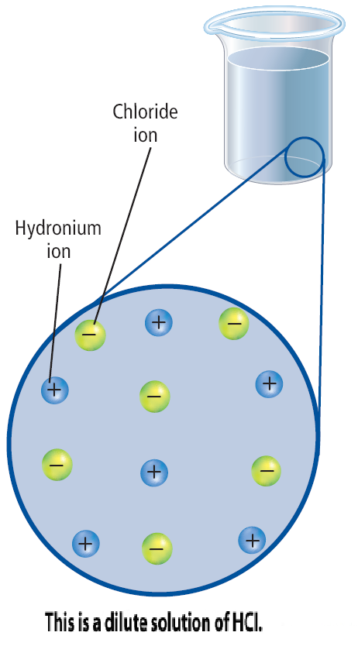
Strength and Concentration
In contrast, the terms dilute and concentrated are used to indicate the concentration of a solution, which is the amount of acid or base dissolved in the solution.

Slide 10
Strength and Concentration
It is possible to have dilute solutions of strong acids and bases and concentrated solutions of weak acids and bases.

Slide 11
pH of a Solution
The pH of a solution is a measure of the concentration of H⁺ ions in it.
The greater the H⁺ concentration is, the lower the pH is and the more acidic the solution is.
The pH measures how acidic or basic a solution is.

Slide 12
pH of a Solution
Solutions with a pH lower than 7 are described as acidic.

Slide 13
pH of a Solution
Solutions with a pH greater than 7 are basic.
A solution with a pH of exactly 7 indicates that the concentrations of H+ ions and OH¯ ions are equal. These solutions are considered neutral.

Slide 14
pH of a Solution
One way to determine pH is by using a universal indicator paper.
This paper undergoes a color change in the presence of H₃O⁺ ions and OH‾ ions in solution.
The final color of the pH paper is matched with colors in a chart to find the pH.

Slide 15
pH of a Solution
An instrument called a pH meter is another tool to determine the pH of a solution.
This meter is operated by immersing the electrodes in the solution to be tested and reading the dial.

Slide 16
Blood pH
In order to carry out its many functions properly, the pH of blood must remain between 7.0 and 7.8.
The main reason for this is that enzymes, the protein molecules that act as catalysts for many reactions in the body, cannot work outside this pH range.

Slide 17
Blood pH
Your blood contains compounds called buffers that enable small amounts of acids or bases to be absorbed without harmful effects.
Buffers are solutions containing ions that react with additional acids or bases to minimize their effects on pH.

Slide 18
Section Check
Question 1
What is the difference between a strong acid and a weak acid?
Answer
In strong acids, nearly all the acid molecules dissociate into ions. In weak acids, a small fraction of the molecules dissolve in water.

Slide 19
Section Check
Question 2
What is the difference between the terms “strength” and “concentration”?
Answer
Strength refers to the ease with which an acid ionizes or base dissociates in solution. Concentration is the amount of an acid or base dissolved in the solution.

Slide 20
Section Check
Question 3
The pH of a solution is a measure of the concentration of _________ in the solution.
A. H⁺
B. H₃O⁺
C. COOH
D. HCl

Slide 21
Section Check
Answer
The answer is A, the greater the H+ concentration, the lower the pH and the more acidic the solution.

