Slide 1
Acids
Although some acids can burn and are dangerous to handle, most acids in foods are safe to eat.
What acids have in common, however, is that they contain at least one hydrogen atom that can be removed when the acid is dissolved in water.

Slide 2
Properties of Acids
An acid is a substance that produces hydrogen ions in a water solution. It is the ability to produce these ions that gives acids their characteristic properties.
When an acid dissolves in water, H⁺ ions interact with water molecules to form H₃O⁺ ions, which are called hydronium ions (hi DROH nee um ⋅ I ahnz).

Slide 3
Properties of Acids
Acids have several common properties.
All acids taste sour.
Taste never should be used to test for the presence of acids.
Acids are corrosive.

Slide 4
Properties of Acids
Acids also react with indicators to produce predictable changes in color.
An indicator is an organic compound that changes color in acid and base. For example, the indicator litmus paper turns red in acid.

Slide 5
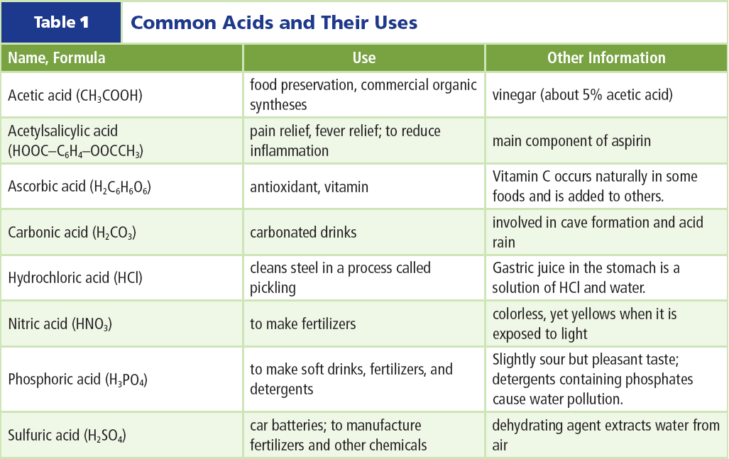
Common Acids
At least four acids (sulfuric, phosphoric, nitric, and hydrochloric) play vital roles in industrial applications.
This lists the names and formulas of a few acids, their uses, and some properties.

Slide 6
Bases
You do not consume many bases.
Some foods, such as egg whites, are slightly basic.
Medicines, such as milk of magnesia and antacids, are basic, too.

Slide 7
Bases
One characteristic of bases is that they feel slippery, like soapy water.
Bases are important in many types of cleaning materials.
Bases can be defined in two ways.

Slide 8
Bases
Any substance that forms hydroxide ions, OH⁻, in a water solution is a base.
In addition, a base is any substance that accepts H⁺ from acids.

Slide 9
Properties of Bases
One way to think about bases is as the complements, or opposites, of acids.
In the pure, undissolved state, many bases are crystalline solids.
In solution, bases feel slippery and have a bitter taste.
Click box to play movie

Slide 10
Properties of Bases
Strong bases are corrosive, and contact with skin can result in severe burns. Therefore, taste and touch never should be used to test for the presence of a base.
Bases react with indicators to produce changes in color. The indicator litmus turns blue in bases.

Slide 11
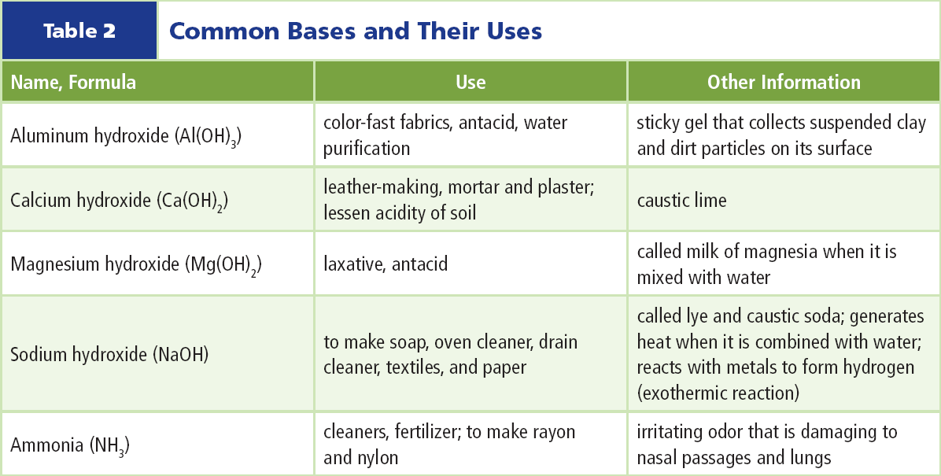
Common Bases
You probably are familiar with many common bases because they are found in cleaning products used in the home.
This table includes uses and some information about bases.

Slide 12
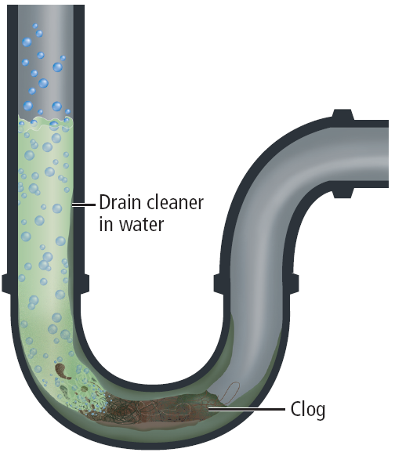
Common Bases
Some drain cleaners contain NaOH, which dissolves grease and small pieces of aluminum.
The aluminum reacts with NaOH, producing hydrogen and dislodging solids, such as hair.

Slide 13
Ionization of Acids
Many of the products that rely on the chemistry of acids and bases are solutions, such as the cleaning products and food products mentioned previously.
The acid separates into ions and the hydrogen atom combines with a water molecule to form hydronium ions (H₃O⁺).

Slide 14
Ionization of Acids
Therefore, an acid can more accurately be described as a compound that produces hydronium ions when dissolved in water.

Slide 15
Ionization of Acids
When hydrogen chloride dissolves in water, a hydronium ion and a chloride ion are produced.

Slide 16
Dissociation of Bases
When bases that contain –OH dissolve in water, the negative areas of nearby water molecules attract the positive ion in the base.
The positive areas of nearby water molecules attract the –OH of the base.

Slide 17
Dissociation of Bases
The base dissociates into a positive ion and a negative ion⎯a hydroxide ion (OH⁻).

Slide 18
Dissociation of Bases
Unlike acid ionization, water molecules do not combine with the ions formed from the base.

Slide 19
Ionization of Bases
Ammonia is a base that does not contain –OH.
In a water solution ionization takes place when the ammonia molecule attracts a hydrogen ion from a water molecule, forming an ammonium ion (NH₄⁺). This leaves a hydroxide ion (OH⁻).

Slide 20
Ionization of Bases
Ammonia is a common household cleaner. However, products containing ammonia never should be used with other cleaners that contain chlorine (sodium hypochlorite), such as some bathroom bowl cleaners and bleach.
Breathing these gases can severely damage lung tissues and cause death.

Slide 21
Section Check
Question 1
What does an acid produce in solution?

Slide 22
Section Check
Answer
An acid produces hydrogen ions in solution, which interact with water molecules to form hydronium ions.

Slide 23
Section Check
Question 2
Which changes color in acids and bases?
A. ammonia
B. antacid
C. detergent
D. litmus

Slide 24
Section Check
Answer
The answer is D. Litmus is an indicator that turns blue in bases and red in acids.

Slide 25
Section Check
Question 3
Any substance that forms __________ in a water solution is a base.
A. H₃O⁺
B. OH–
C. H⁺⁺
D. H₂O

Slide 26
Section Check
Answer
The answer is B. A base is any substance that forms hydroxide ions in water.

