Slide 1
Chemical Reactions—Energy Exchanges
A dynamic explosion is an example of a rapid chemical reaction.
Most chemical reactions proceed more slowly, but all chemical reactions release or absorb energy.

Slide 2
Chemical Reactions—Energy Exchanges
This energy can take many forms, such as heat, light, sound, or electricity.
Chemical bonds are the source of this energy.

Slide 3
Chemical Reactions—Energy Exchanges
When most chemical reactions take place, some chemical bonds in the reactants are broken, which requires energy.
In order for products to be produced, new bonds must form. Bond formation releases energy.

Slide 4
More Energy Out
Chemical reactions that release energy are called exergonic (ek sur GAH nihk) reactions.
In these reactions less energy is required to break the original bonds than is released when new bonds form.

Slide 5
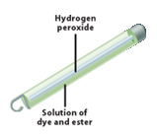
More Energy Out
As a result, some form of energy, such as light or heat is given off by the reaction.
The familiar glow from the reaction inside a glow stick is an example of an exergonic reaction, which produces visible light.

Slide 6
Heat Released
When the energy given off in a reaction is primarily in the form of heat, the reaction is called an exothermic reaction.
The burning of wood and the explosion of dynamite are exothermic reactions.

Slide 7
More Energy In
Sometimes a chemical reaction requires more energy to break bonds than is released when new ones are formed.
These reactions are called endergonic reactions.
The energy absorbed can be in the form of light, heat or electricity.

Slide 8
Thermal Energy Absorbed
When the energy needed is in the form of heat, the reaction is called an endothermic reaction.
Some reactions are so endothermic that they can cause water to freeze.
Adding Epsom salt to water will cause the solution to become cold. The dissolving Epson salt absorbs thermal energy.

Slide 9
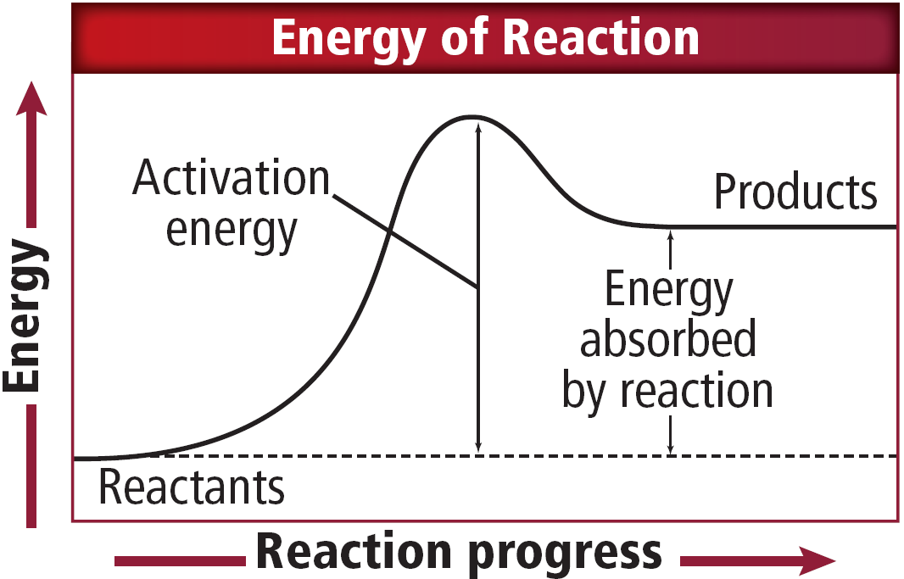
Thermal Energy Absorbed
This graph shows how energy is absorbed during chemical reactions.

Slide 10
Section Check
Question 1
What is the difference between exergonic and exothermic?
Answer
An exergonic reaction is a chemical reaction that releases energy. An exothermic reaction is an exergonic reaction that releases heat.

Slide 11
Section Check
Question 2
When heat is needed for a chemical reaction, it is called an __________ reaction.
A. endergonic
B. endothermic
C. exergonic
D. exothermic

Slide 12
Section Check
Answer
The answer is B. In an endothermic reaction, energy is needed in the form of heat.

Slide 13
Section Check
Question 3
When bonds are formed, energy is _____.
Answer
released

