Slide 1
Types of Reactions
There are literally millions of chemical reactions that occur every day.
Chemists have defined five main categories of chemical reactions: combustion, synthesis, decomposition, single displacement, and double displacement.

Slide 2
Combustion Reactions
If you have ever observed something burning, you have observed a combustion reaction.
Our definition states that a combustion reaction occurs when a substance reacts with oxygen to produce energy in the form of heat and light.

Slide 3
Combustion Reactions
Combustion reactions also produce one or more products that contain the elements in the reactants.

Slide 4
Synthesis Reactions
In a synthesis reaction, two or more substances combine to form another substance.
The generalized formula for this reaction type is as follows: A + B → AB.

Slide 5
Decomposition Reactions
A decomposition reaction is just the reverse of a synthesis.
Instead of two substances coming together to form a third, a decomposition reaction occurs when one substance breaks down, or decomposes, into two or more substances.

Slide 6
Decomposition Reactions
The general formula for this type of reaction can be expressed as follows: AB → A + B.
Most decomposition reactions require the use of heat, light, or electricity.

Slide 7
Single Displacement
When one element replaces another element in a compound, it is called a single-displacement reaction.
Single-displacement reactions are described by the general equation A + BC → AC + B.
Here you can see that atom A displaces atom B to produce a new molecule AC, a single displacement reaction.

Slide 8
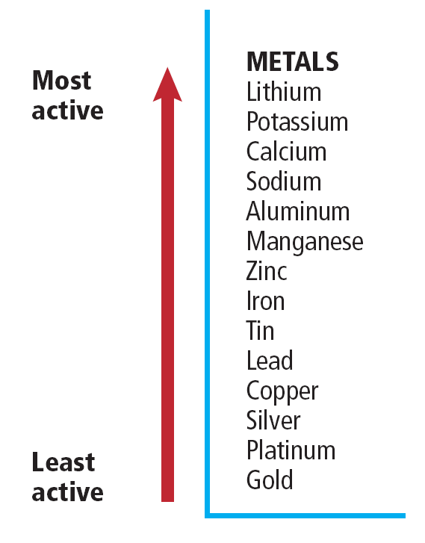
Single Displacement
We can predict which metal will replace another using the diagram shown which lists metals according to how reactive they are.
A metal will replace any less active metal.

Slide 9
Double Displacement
In a double-displacement reaction, the positive ion of one compound replaces the positive ion of the other to form two new compounds.
A double displacement reaction takes place if a precipitate, water, or a gas forms when two ionic compounds in solution are combined.

Slide 10
Double Displacement
A precipitate is an insoluble compound that comes out of solution during this type of reaction.
The generalized formula for this type of reaction is as follows:
AB + CD → AD + CB.

Slide 11
Oxidation-Reduction Reactions
One characteristic that is common to many chemical reactions is the tendency of the substances to lose or gain electrons.
Chemists use the term oxidation to describe the loss of electrons and the term reduction to describe the gain of electrons.

Slide 12
Oxidation-Reduction Reactions
Chemical reactions involving electron transfer of this sort often involve oxygen, which is very reactive, pulling electrons from metallic elements.
Corrosion of metal is a visible result.

Slide 13
Oxidation-Reduction Reactions
The substance that gains an electron or electrons obviously becomes more negative, so we say it is reduced.
On the other hand, the substance that loses an electron or electrons then becomes more positive, and we say it is oxidized.

Slide 14
Oxidation-Reduction Reactions
The electrons that were pulled from one atom were gained by another atom in a chemical reaction called reduction.
Reduction is the partner to oxidation; the two always work as a pair, which is commonly referred to as redox.

Slide 15
Section Check
Question 1
In a _________ reaction, two or more substances combine to form another substance.
A. combustion
B. displacement
C. decomposition
D. synthesis

Slide 16
Section Check
Answer
The answer is D. The generalized formula for synthesis reactions is A + B → AB.

Slide 17
Section Check
Question 2
The opposite of a synthesis reaction is a __________ reaction.
A. combustion
B. double displacement
C. decomposition
D. single displacement

Slide 18
Section Check
Answer
The answer is C. A decomposition reaction occurs when one substance breaks down into two or more substances.

Slide 19
Section Check
Question 3
The reaction in which the positive ion of one compound replaces the positive ion of the other to form two new compounds is the __________ reaction.
A. combustion
B. double displacement
C. decomposition
D. single displacement

Slide 20
Section Check
Answer
The answer is B. A double displacement takes place if a precipitate, water, or a gas form when two ionic compounds in solution are combined.

