Slide 1
Lavoisier and the Conservation of Mass
Chemical reactions are taking place all around you and even within you.
A chemical reaction is a change in which one or more substances are converted into new substances.

Slide 2
Lavoisier and the Conservation of Mass
The substances that react are called reactants.
The new substances produced are called products.
This relationship can be written as follows:

Slide 3
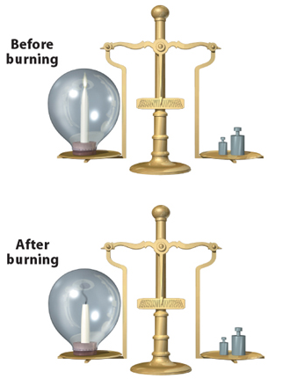
Lavoisier and the Conservation of Mass
The French chemist Antoine Lavoisier established that the total mass of the products always equals the total mass of the reactants.
For example, the mass of the candles and oxygen before burning is exactly equal to the mass of the remaining candle and gaseous products.

Slide 4
Lavoisier and the Conservation of Mass
One of the questions that motivated Lavoisier was the mystery of exactly what happened when substances changed form.
He began to answer this question by experimenting with mercury.

Slide 5
Lavoisier and the Conservation of Mass
Lavoisier placed a carefully measured mass of solid mercury (II) oxide, which he knew as mercury calx, into a sealed container.
When he heated this container, he noted a dramatic change.
The red powder had been transformed into a silvery liquid that he recognized as mercury metal, and a gas was produced.

Slide 6
Lavoisier and the Conservation of Mass
When he determined the mass of the liquid mercury and gas, their combined masses were exactly the same as the mass of the red powder he had started with.
Lavoisier also established that the gas produced by heating mercury(II) oxide, which we call oxygen, was a component of air.

Slide 7
Writing Equations
Scientists have developed a shorthand method to describe chemical reactions.
A chemical equation is a way to describe a chemical reaction using chemical formulas and other symbols.

Slide 8
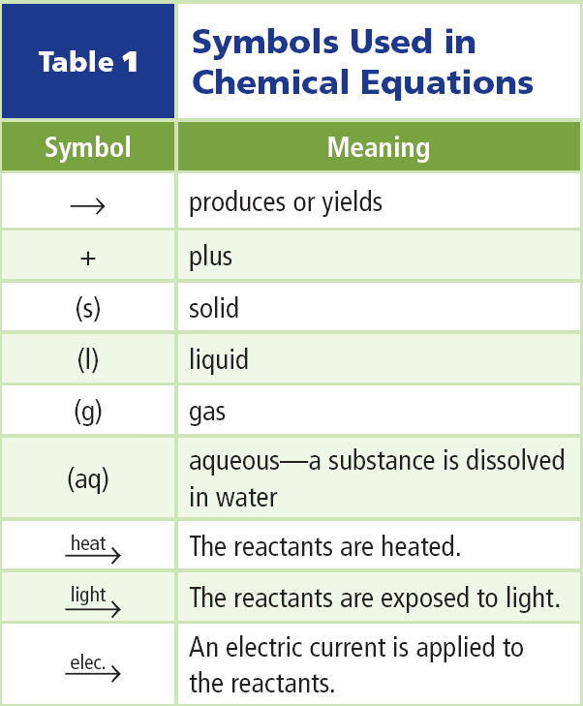
Writing Equations
Some of the symbols used in chemical equations are listed in the table.

Slide 9
Balancing Equations
Lavoisier's mercury(II) oxide reaction can be written as:
Notice that the number of mercury atoms is the same on both sides of the equation but that the number of oxygen atoms is not the same.

Slide 10
Balancing Equations
One oxygen atom appears on the reactant side of the equation and two appear on the product side.
According to the law of conservation of mass, one oxygen atom cannot just become two. Nor can you simply add the subscript 2 and write HgO₂ instead of HgO.

Slide 11
Balanced Equations
The formulas in a chemical equation must accurately represent the compounds that react.
Fixing this equation requires a process called balancing.
The balancing process involves changing coefficients in a reaction to achieve a balanced chemical equation, which has the same number of atoms of each element on both sides of the equation.

Slide 12
Choosing Coefficients
Finding out which coefficients to use to balance an equation is often a trial-and-error process.
In the equation for Lavoisier's experiment, the number of mercury atoms is balanced, but one oxygen atom is on the left and two are on the right.

Slide 13
Choosing Coefficients
If you put a coefficient of 2 before the HgO on the left, the oxygen atoms will be balanced, but the mercury atoms become unbalanced.
To balance the equation, also put a 2 in front of mercury on the right. The equation is now balanced.

Slide 14
Try Your Balancing Act
Magnesium burns with such a brilliant white light that it is often used in emergency flares, fireworks and sparklers.
Burning leaves a white powder called magnesium oxide.
To write a balanced chemical equation for this and most other reactions, follow these four steps.

Slide 15
Try Your Balancing Act
Step 1 Write a chemical equation for the reaction using formulas and symbols.
Step 2 Count the atoms in reactants and products.

Slide 16
Try Your Balancing Act
Step 3 Choose coefficients that balance the equation.
Remember, never change subscripts of a correct formula to balance an equation.

Slide 17
Understanding Chemical Equations
When charcoal burns, carbon (C) combines with oxygen (O₂) to form carbon dioxide (CO₂).

Slide 18
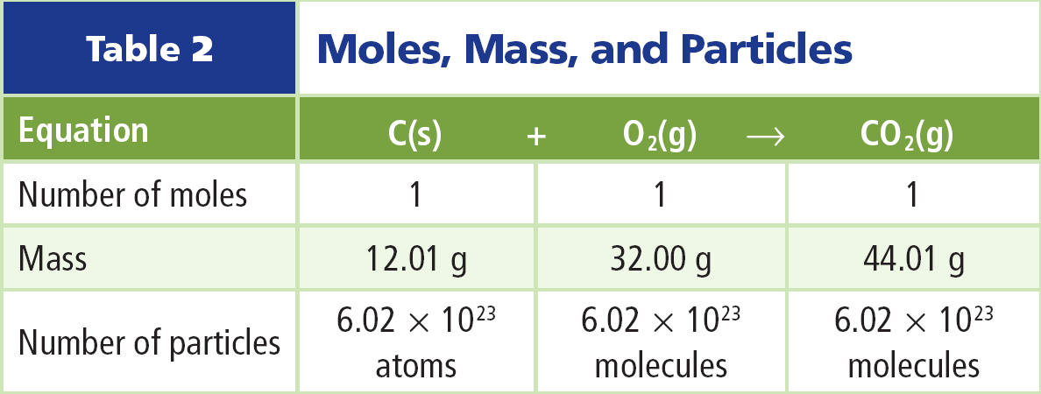
Moles
It is not feasible for scientists to work with individual atoms and molecules; so they work in grams.
One mole is the amount of a substance that contains 6.02 × 10²³ particles of that substances.

Slide 19
Molar Mass
The molar mass is the mass in grams of one mole of a substance.
The molar mass and the atomic mass of an element are related:
Molar mass can be used to convert between mass of a substance and number of moles.

Slide 20
Section Check
Question 1
What is a chemical reaction?
Answer
A process is a chemical reaction if one or more substances change into new substances.

Slide 21
Section Check
Question 2
The principle that the total starting mass of all reactants equals the total final mass of all products is known as __________.
Answer
This is the law of conservation of mass; during a chemical change, matter can neither be created nor destroyed.

Slide 22
Section Check
Question 3
Describe the products in the following reaction:
A. aqueous
B. liquid
C. solid and liquid
D. solid and aqueous

Slide 23
Section Check
Answer
The answer is D. The products are solid nickel(II) hydroxide and aqueous sodium chloride.

Slide 24
Section Check
Question 4
What does it mean for a chemical equation to be balanced?
compounds exist in the same amounts
both before and after a reaction
coefficients are the same for the reactants
as for the products

Slide 25
Section Check
there are the same number of atoms of
each element on both sides of the
chemical reaction
the rate of formation of products is equal
to the rate of formation of reactants

Slide 26
Section Check
Answer
The answer is C. Balancing an equation does not change what happens in the reaction.

Slide 27
Section Check
Question 5
What is the correct balanced equation for the reaction of magnesium and oxygen?
A. Mg(s) + O(g) → MgO(s)
B. Mg(s) + O₂(g) → MgO(s)
C. Mg₂(s) + O₂(g) → 2MgO(s)
D. 2Mg(s) + O₂(g) → 2MgO(s)

Slide 28
Section Check
Answer
The answer is D. Oxygen is a diatomic molecule. To balance an equation, change the coefficients, not the subscripts.

